Slide 1
Project Update
1/23/2021
David Chen

Slide 2
Overview
Differences between Normalized Clustering Approaches
Primer 1 and 2 Analysis
MaGeCK Maximum Likelihood Estimation Implementation

Slide 3
Difference between Normalized Clustering Approaches

Slide 4
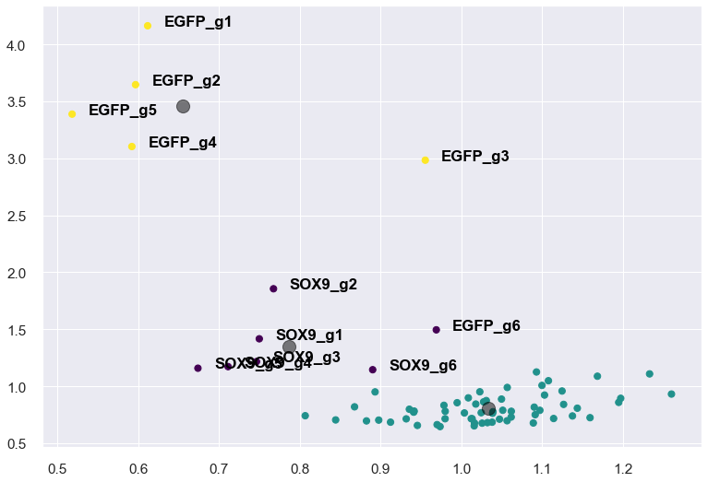
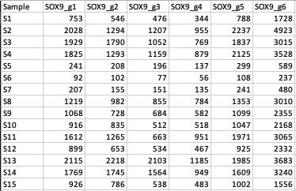
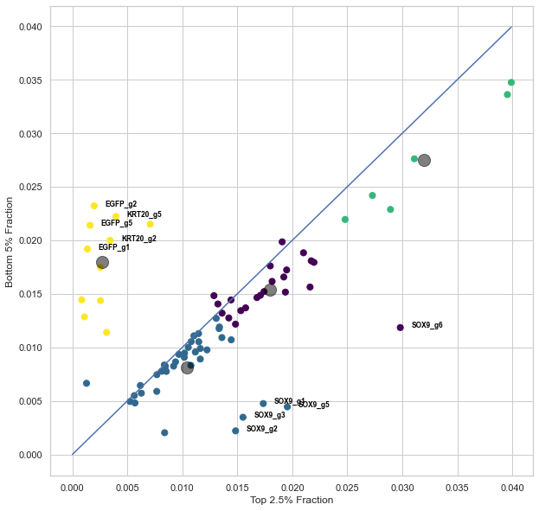
Differences in Normalization Workflow
MiniScreen01_normalized data.xlsx
Total Read Normalization
Library Pool Normalization
Population Level Normalization
Top Fraction Fold Change
MiniScreen04_Samples_Fractions_and_RawCounts.xlsx
Total Read Normalization
Top Fraction Fold Change

Slide 5
Regression Analysis and
K-means Clustering

Slide 6
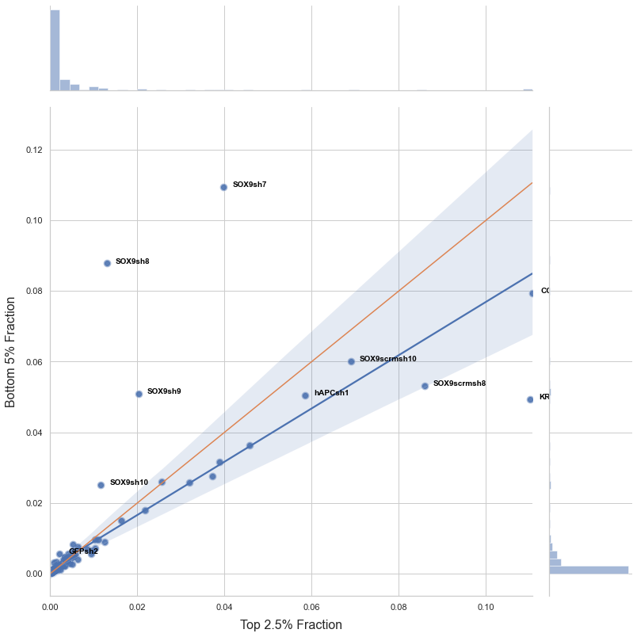
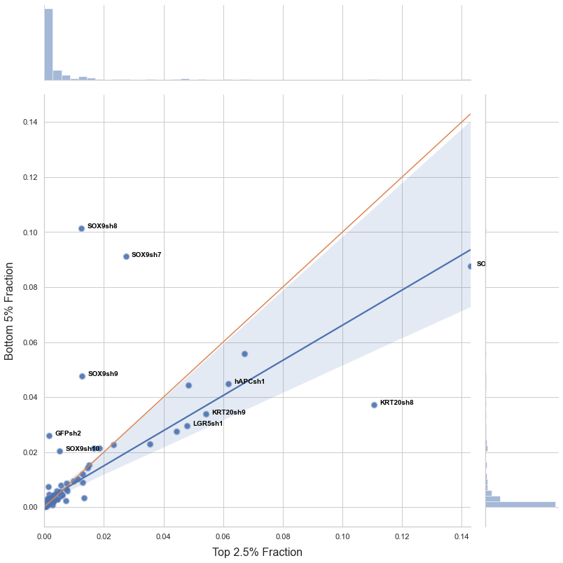
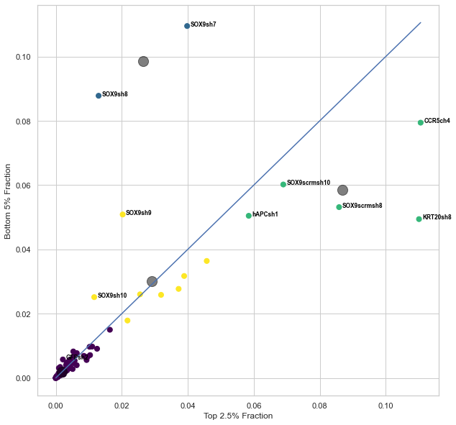
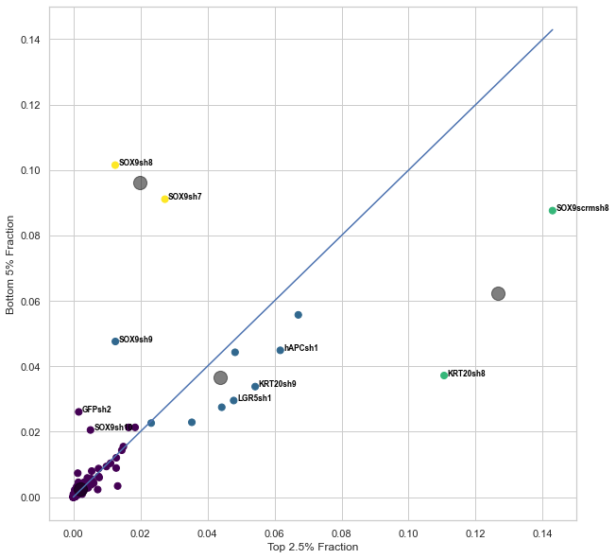
Primer 1
Top 2.5% vs Bottom 5%
Day 3
Day 7

Slide 7
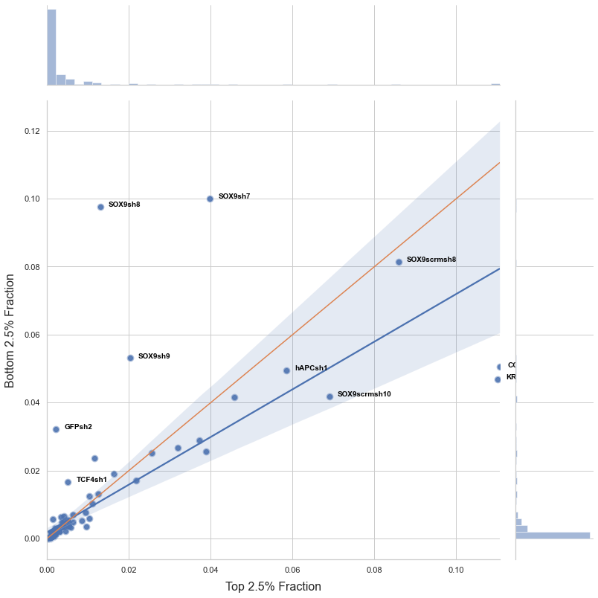
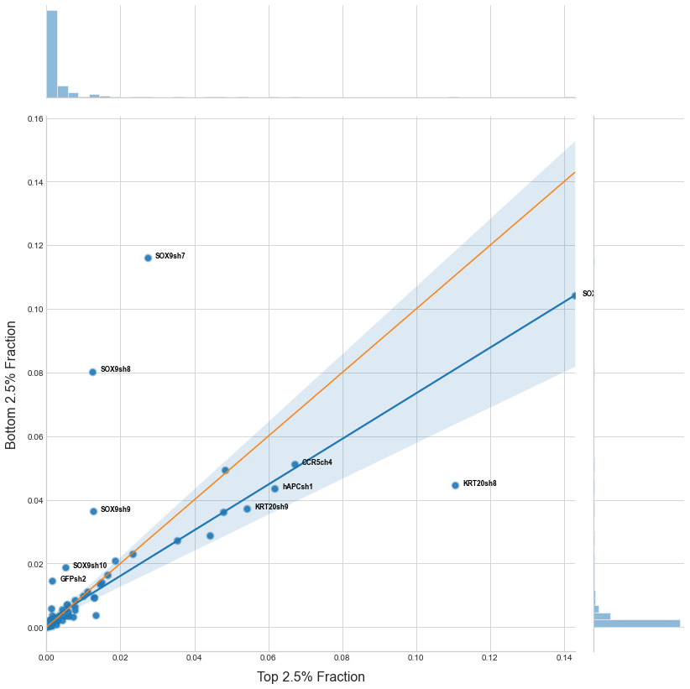
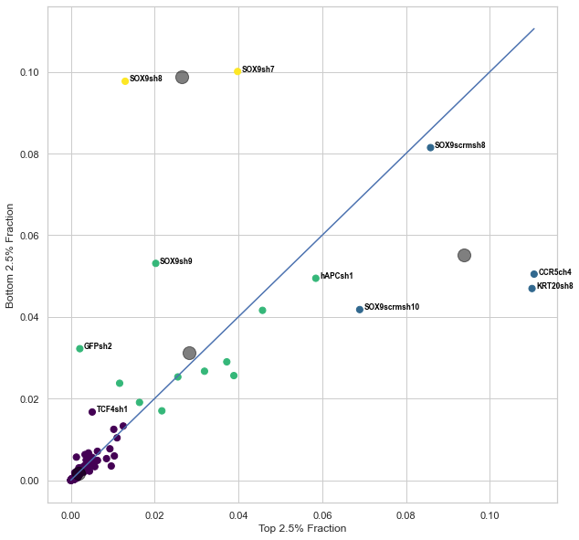
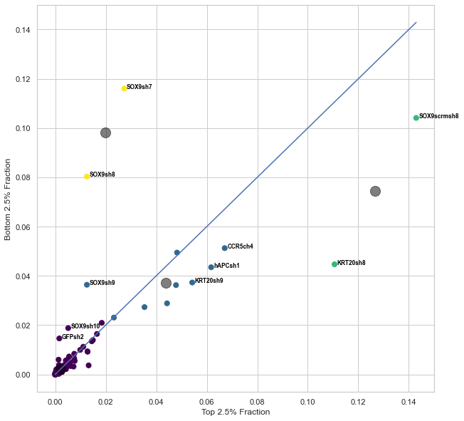
Primer 1
Top 2.5% vs Bottom 2.5%
Day 3
Day 7

Slide 8
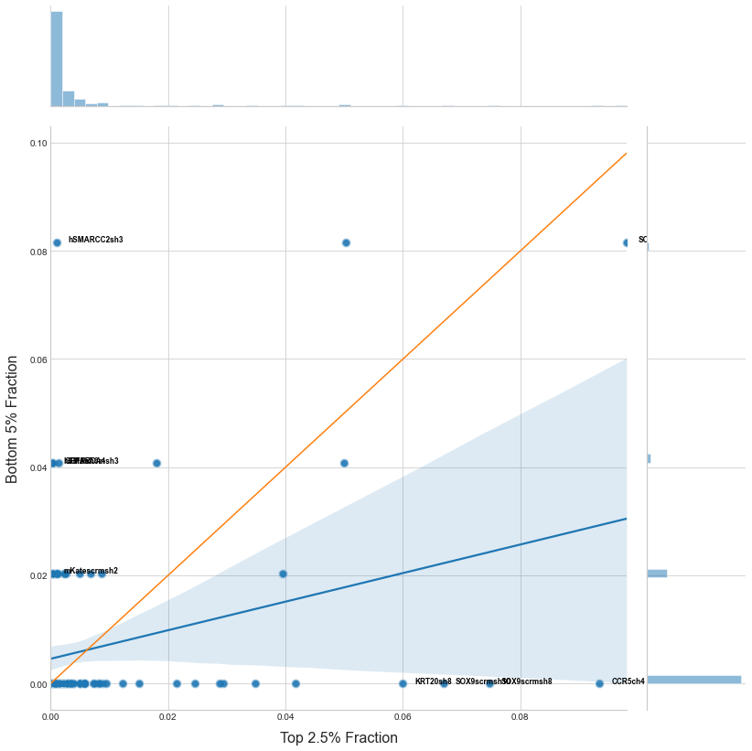
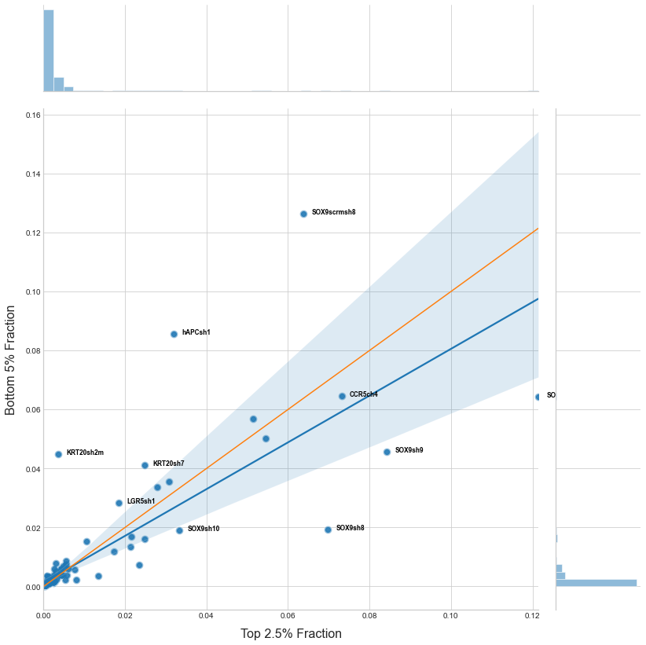
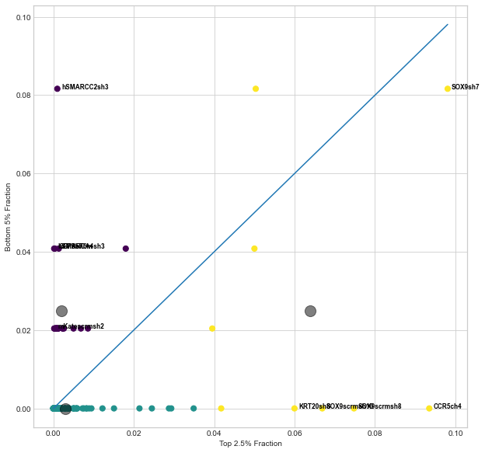
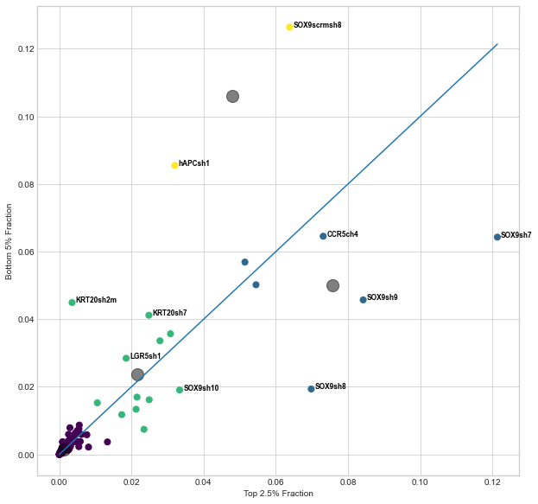
Primer 2
Top 2.5% vs Bottom 5%
Day 3
Day 7

Slide 9
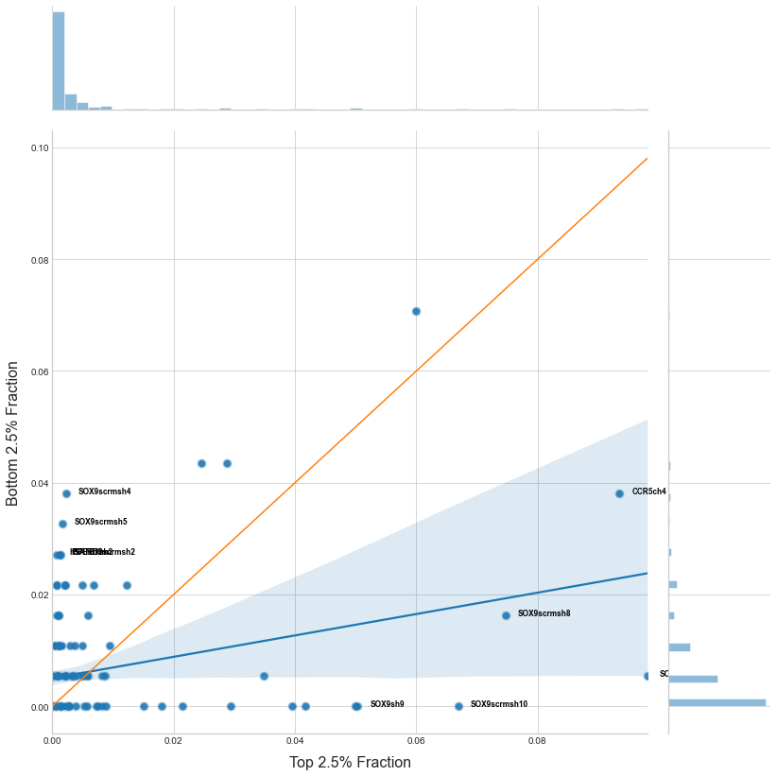
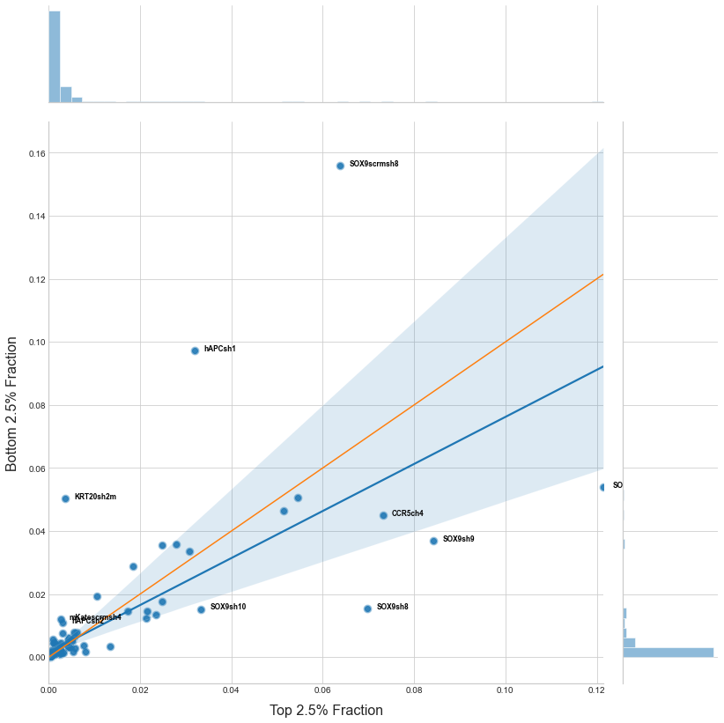
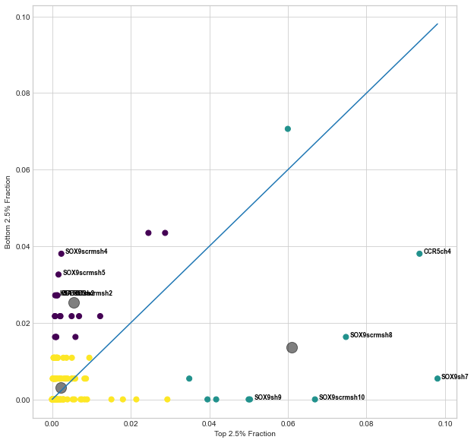
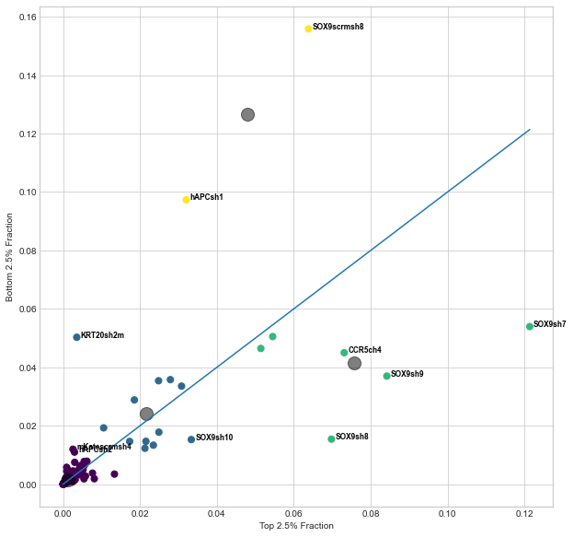
Primer 2
Top 2.5% vs Bottom 2.5%
Day 3
Day 7

Slide 10
MaGeCK Gene
Positive and Negative
Selection P-value

Slide 11
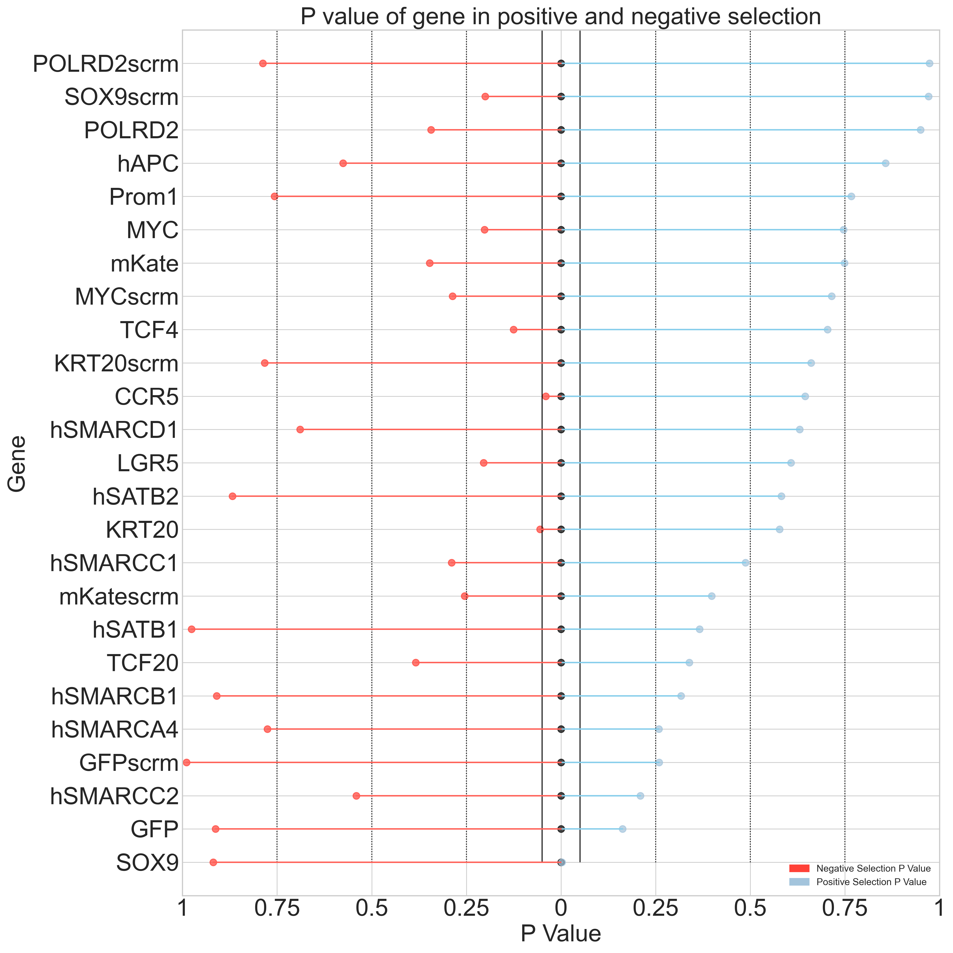
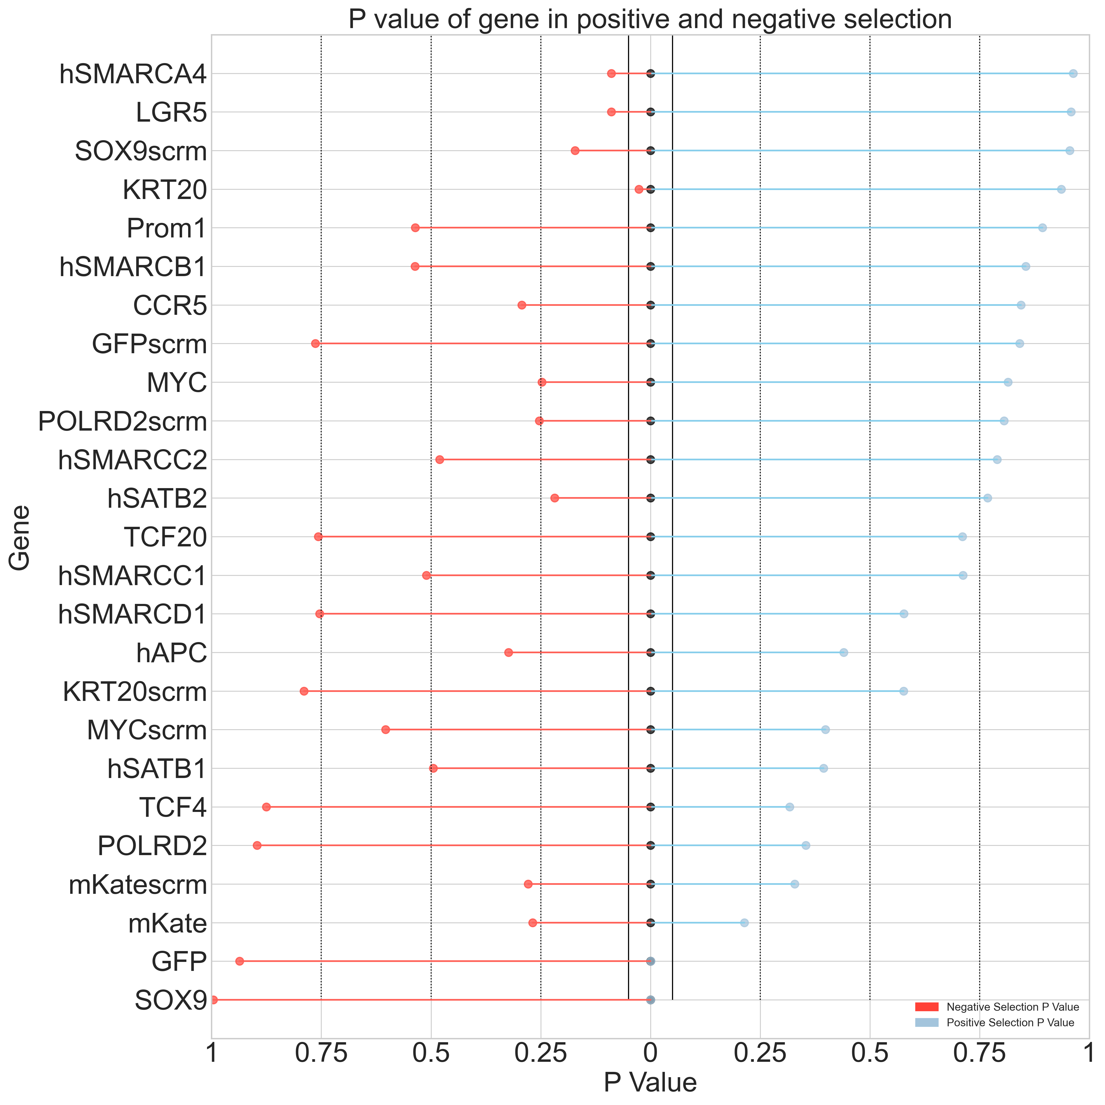
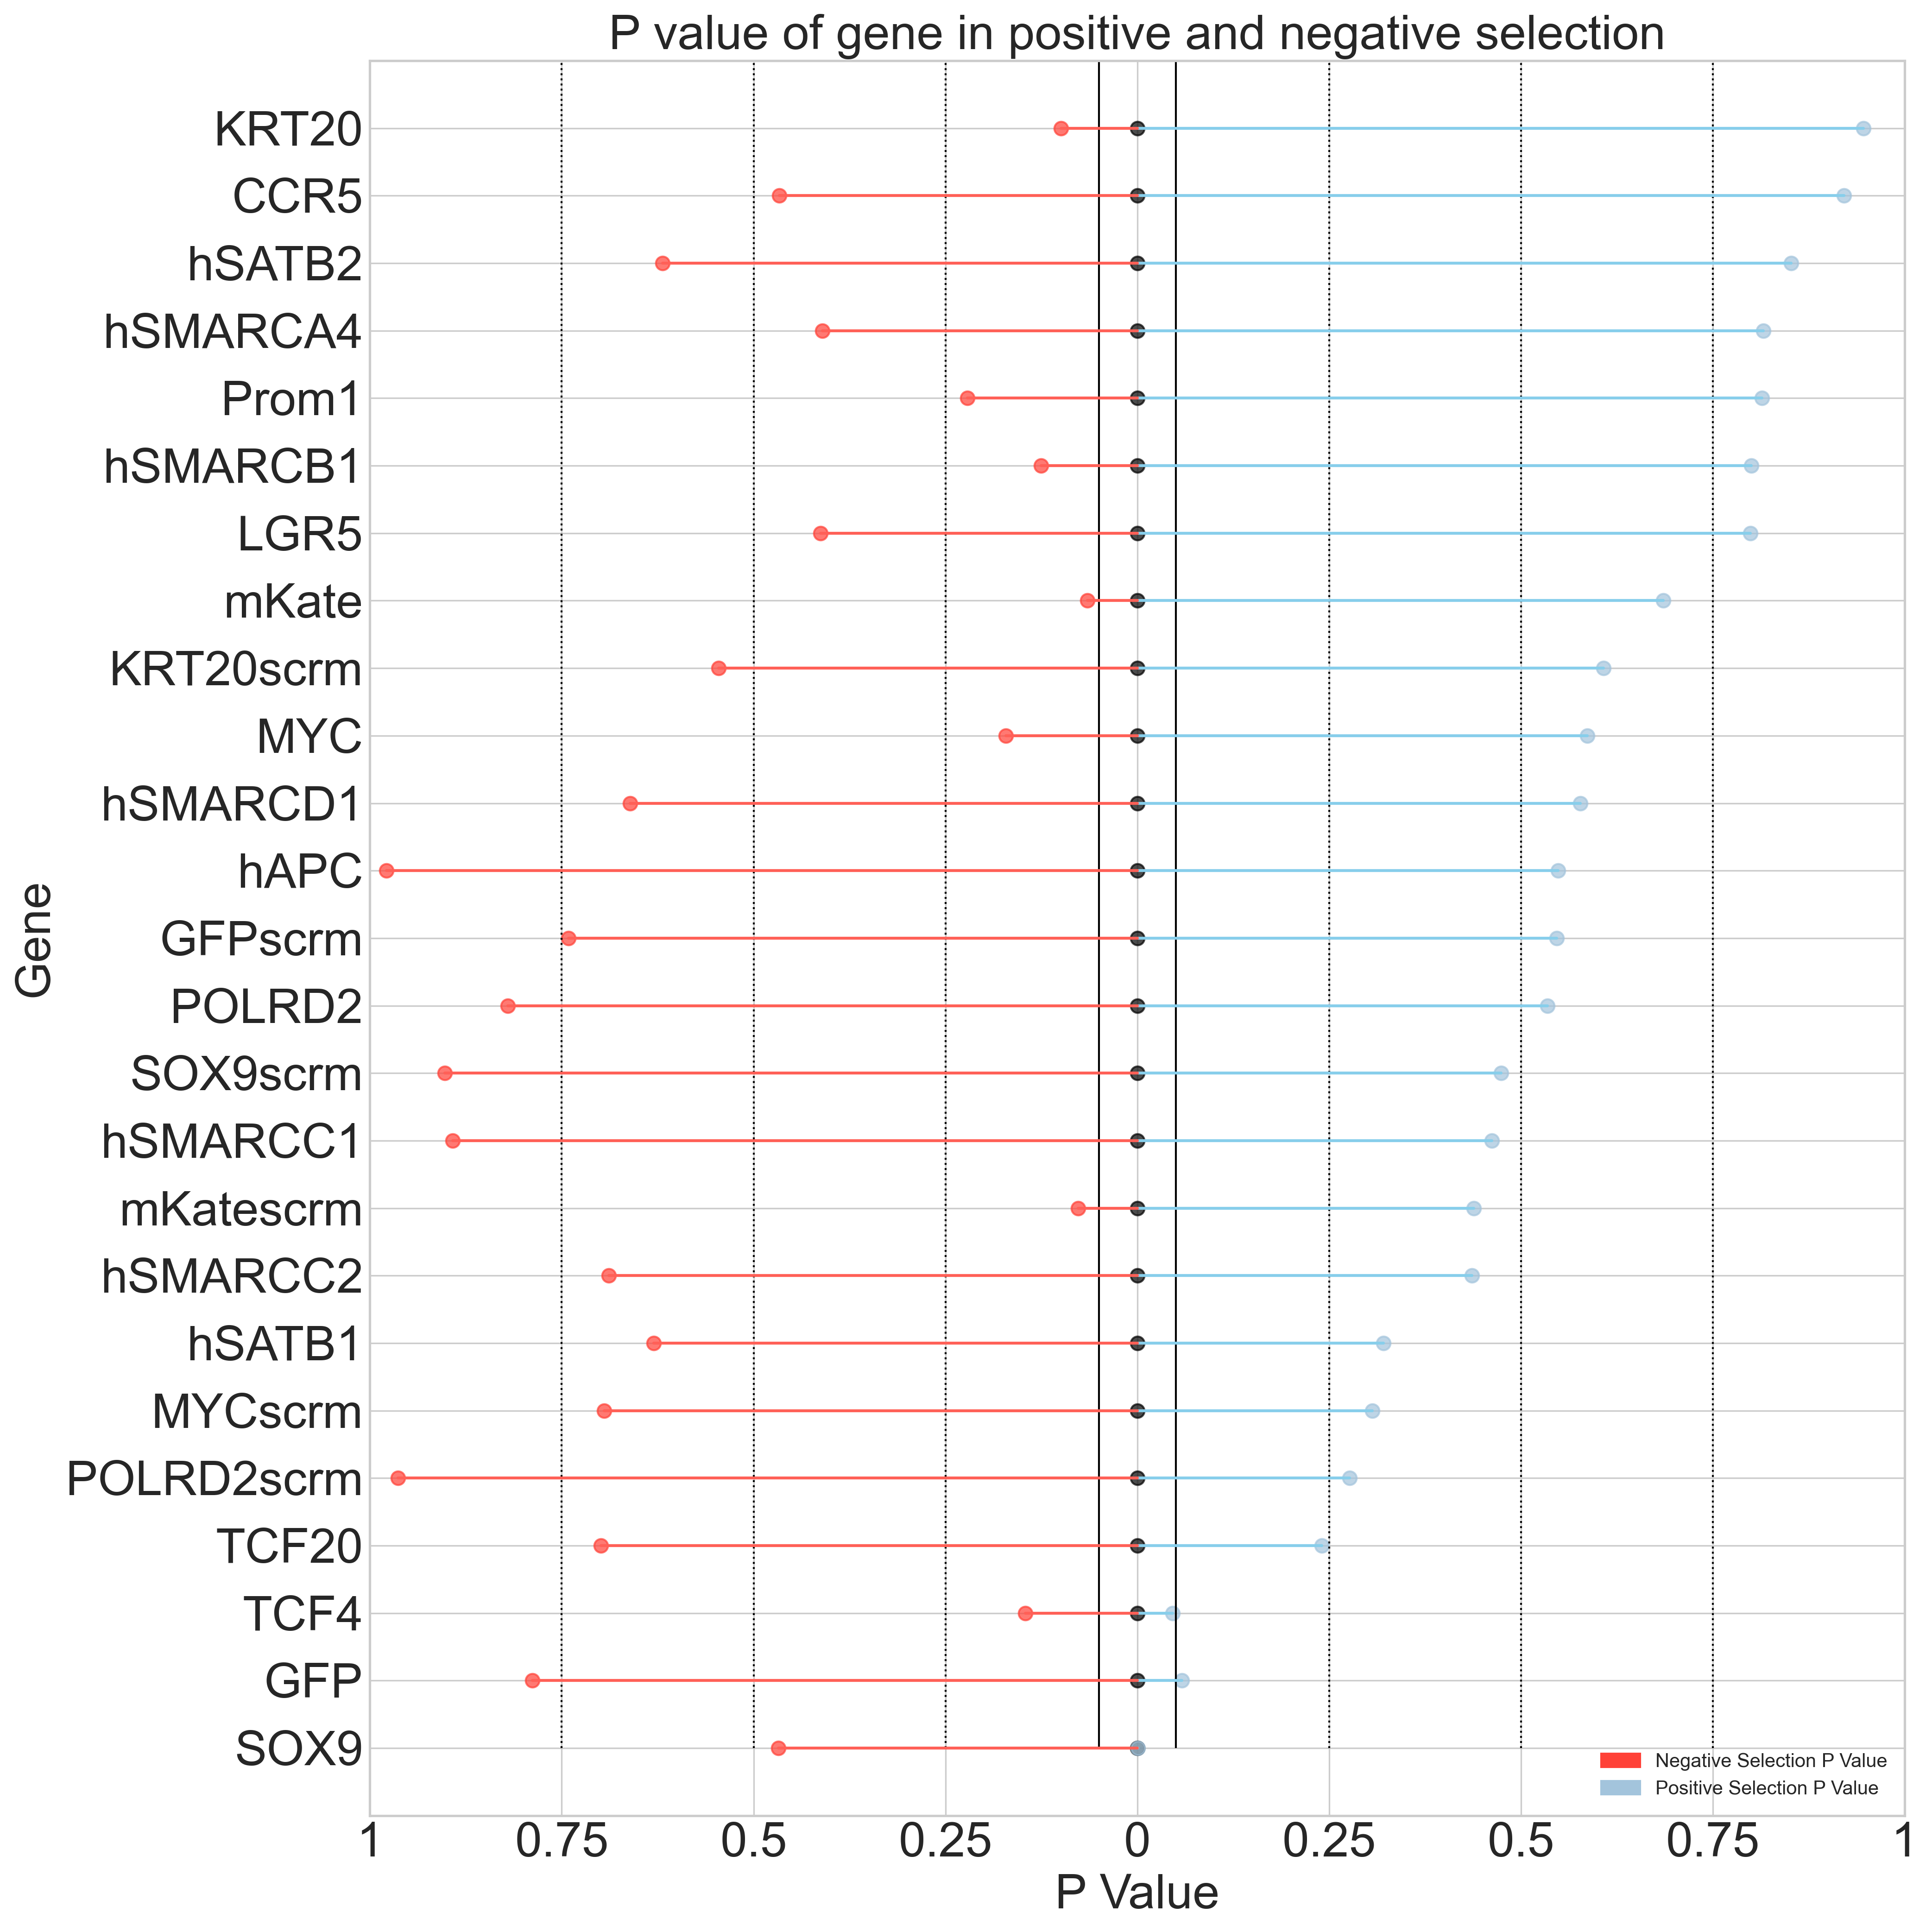
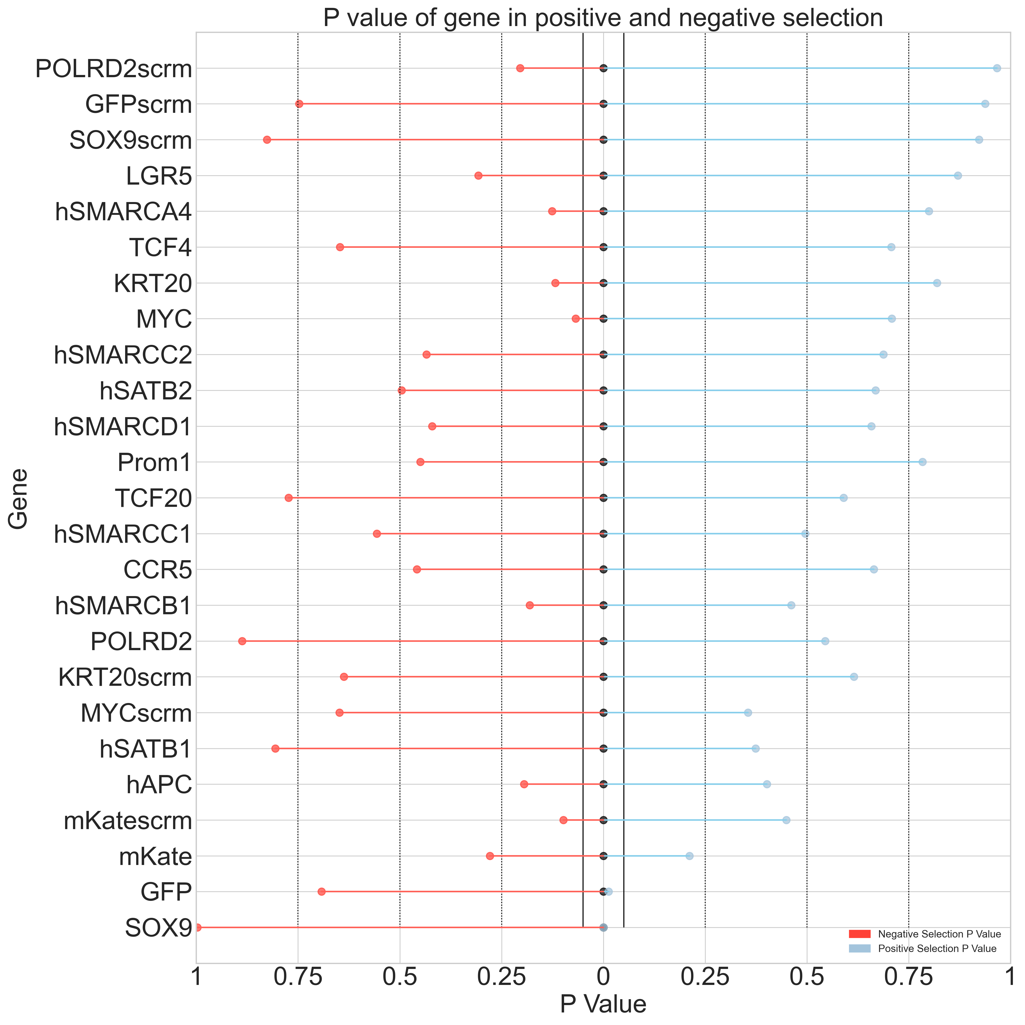
Primer 1
Top 2.5% vs Bottom 5%
Top 2.5% vs Bottom 2.5%
Day 3
Day 7
Day 3
Day 7
* Indicates P value < 0.05
*SOX9
*SOX9
*EGFP
*SOX9
*CCR5
*KRT20
*TCF4
*EGFP
*GFP

Slide 12
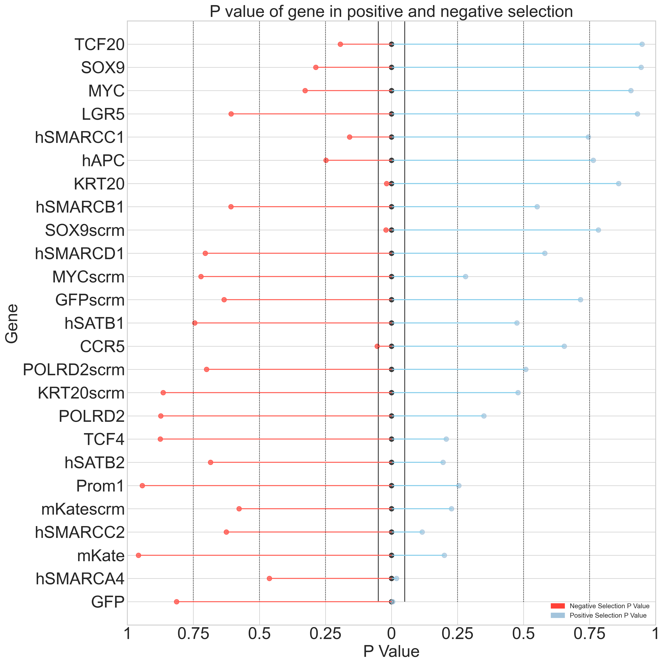
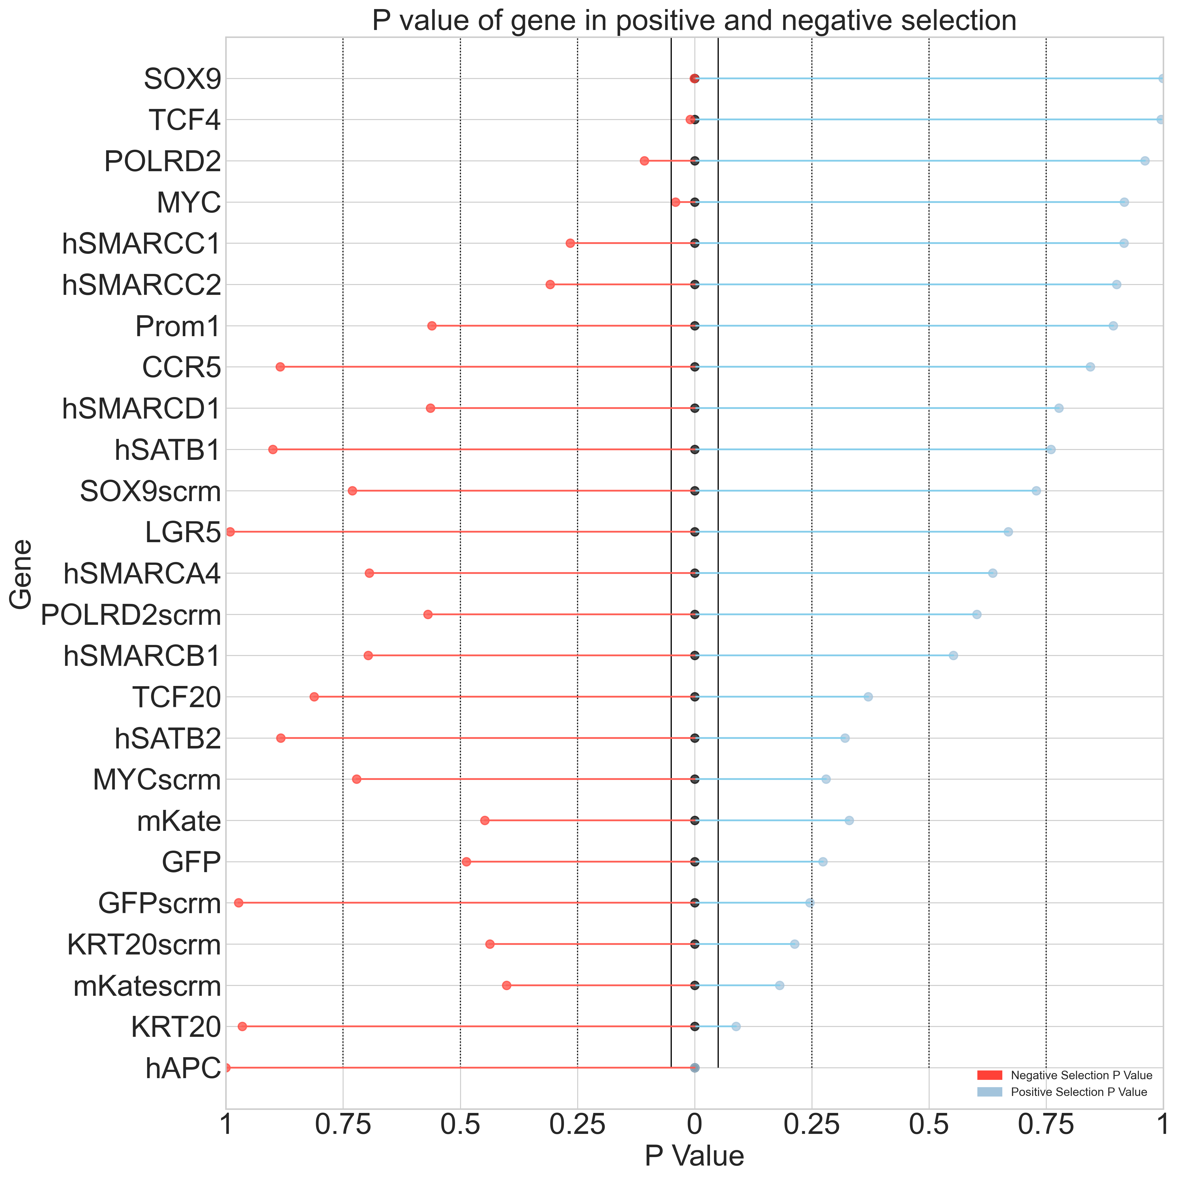
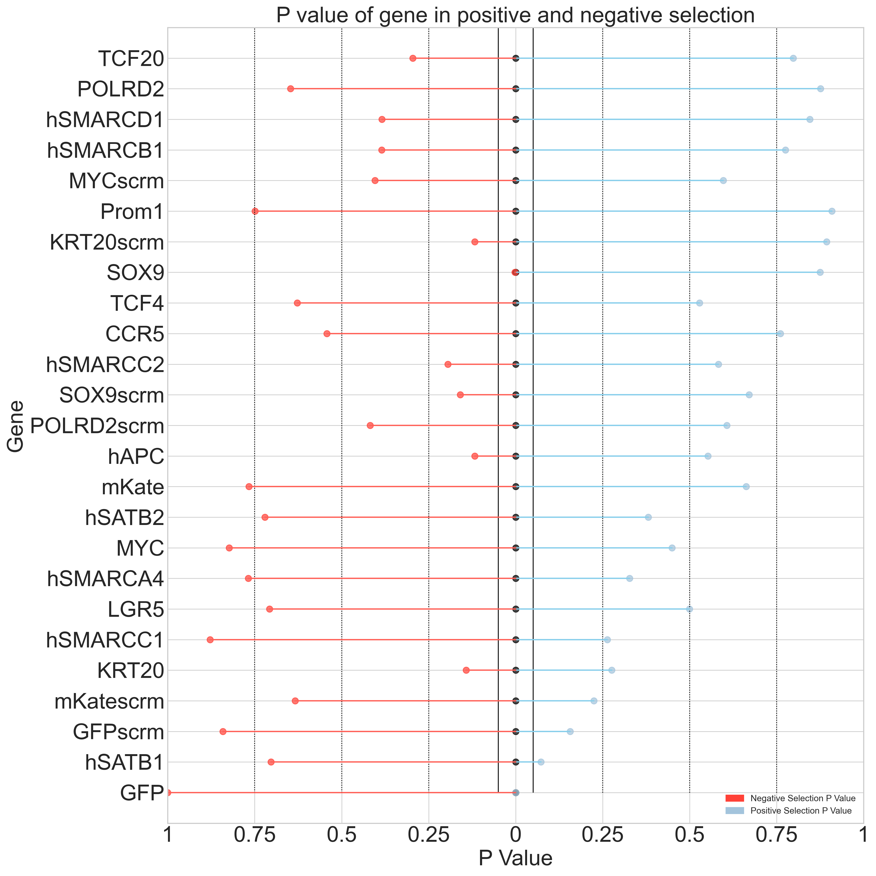
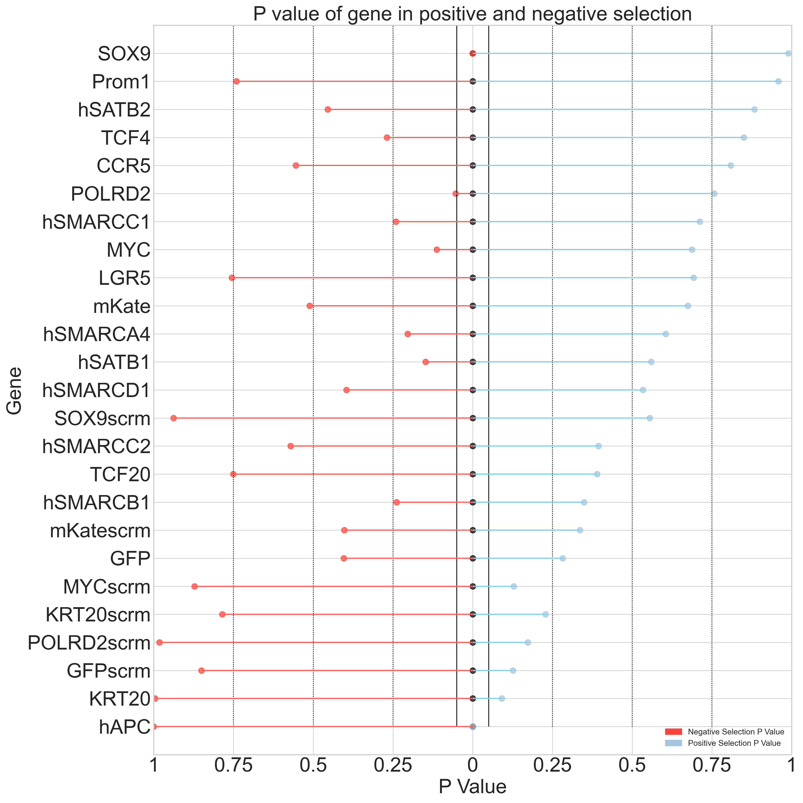
Primer 2
Top 2.5% vs Bottom 5%
Top 2.5% vs Bottom 2.5%
Day 3
Day 7
Day 3
Day 7
* Indicates P value < 0.05
*KRT20
*GFP
*hAPC
*GFP
*hAPC
*hSMARCA4
*SOX9
*SOX9
*SOX9scrm
*TCF4
*MYC

Slide 13
MaGeCK sgRNA RRA score and Two-sided P value

Slide 14
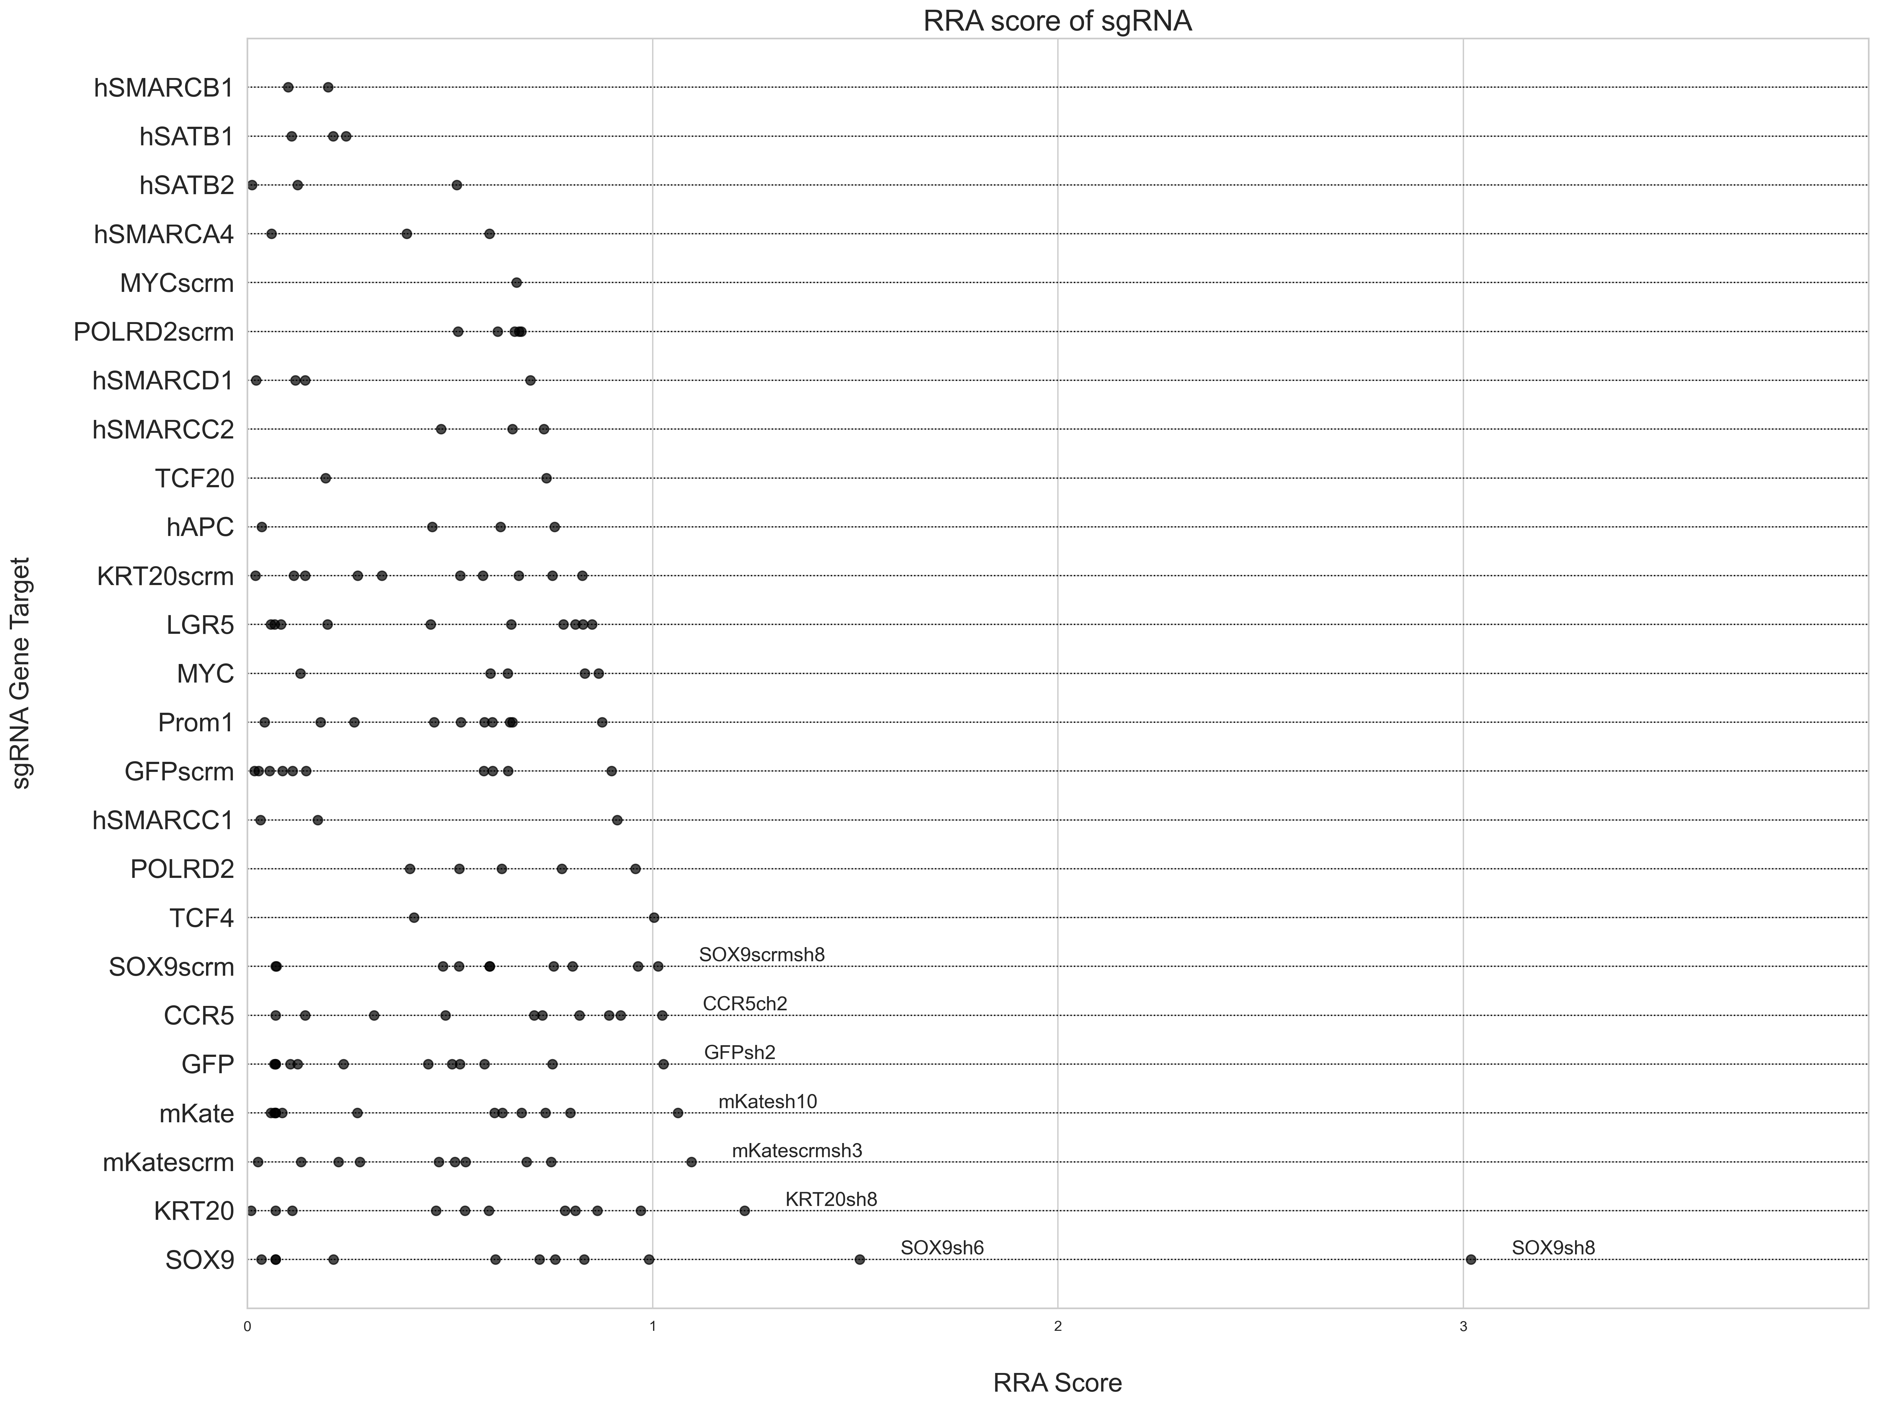
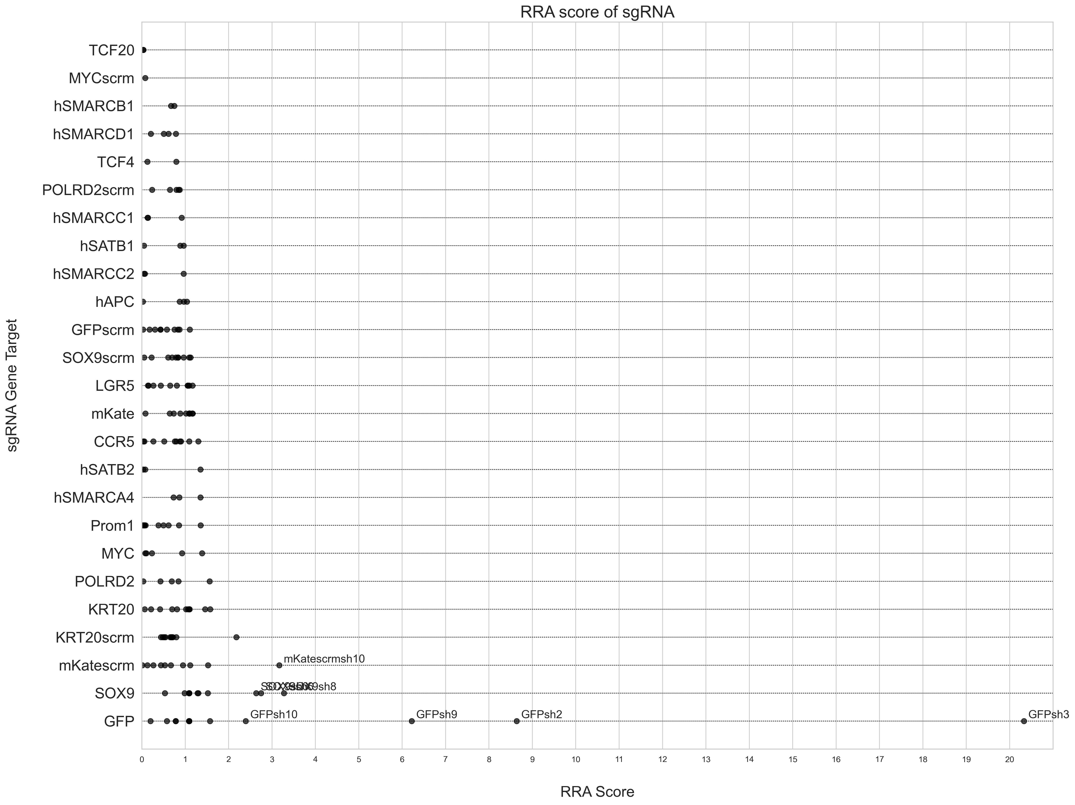
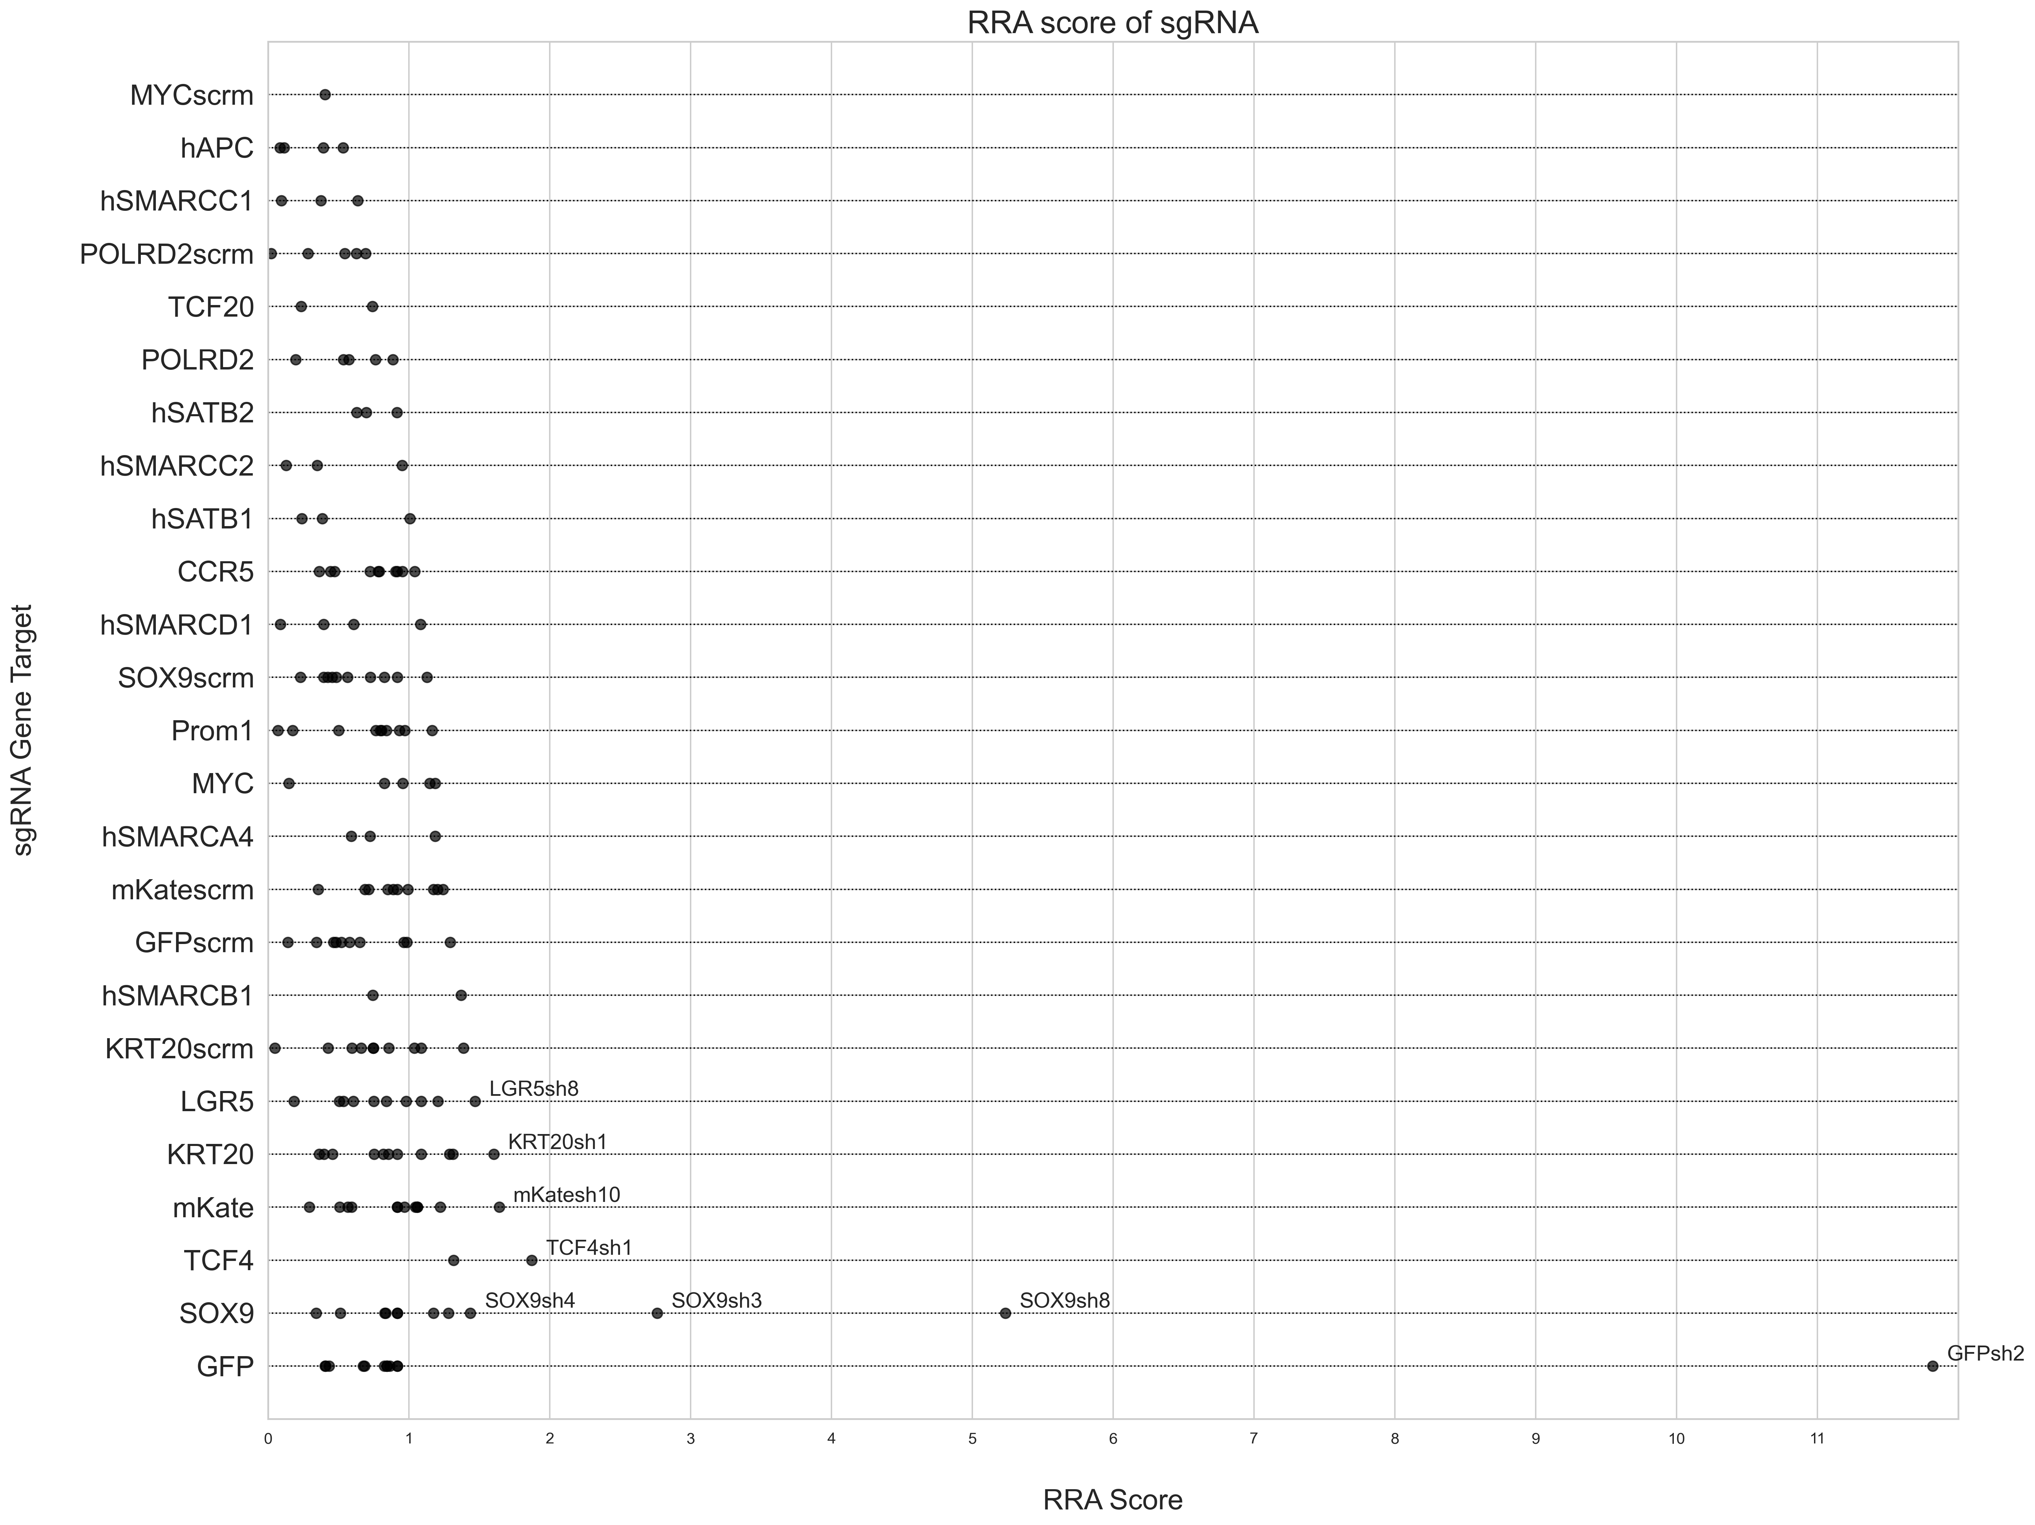
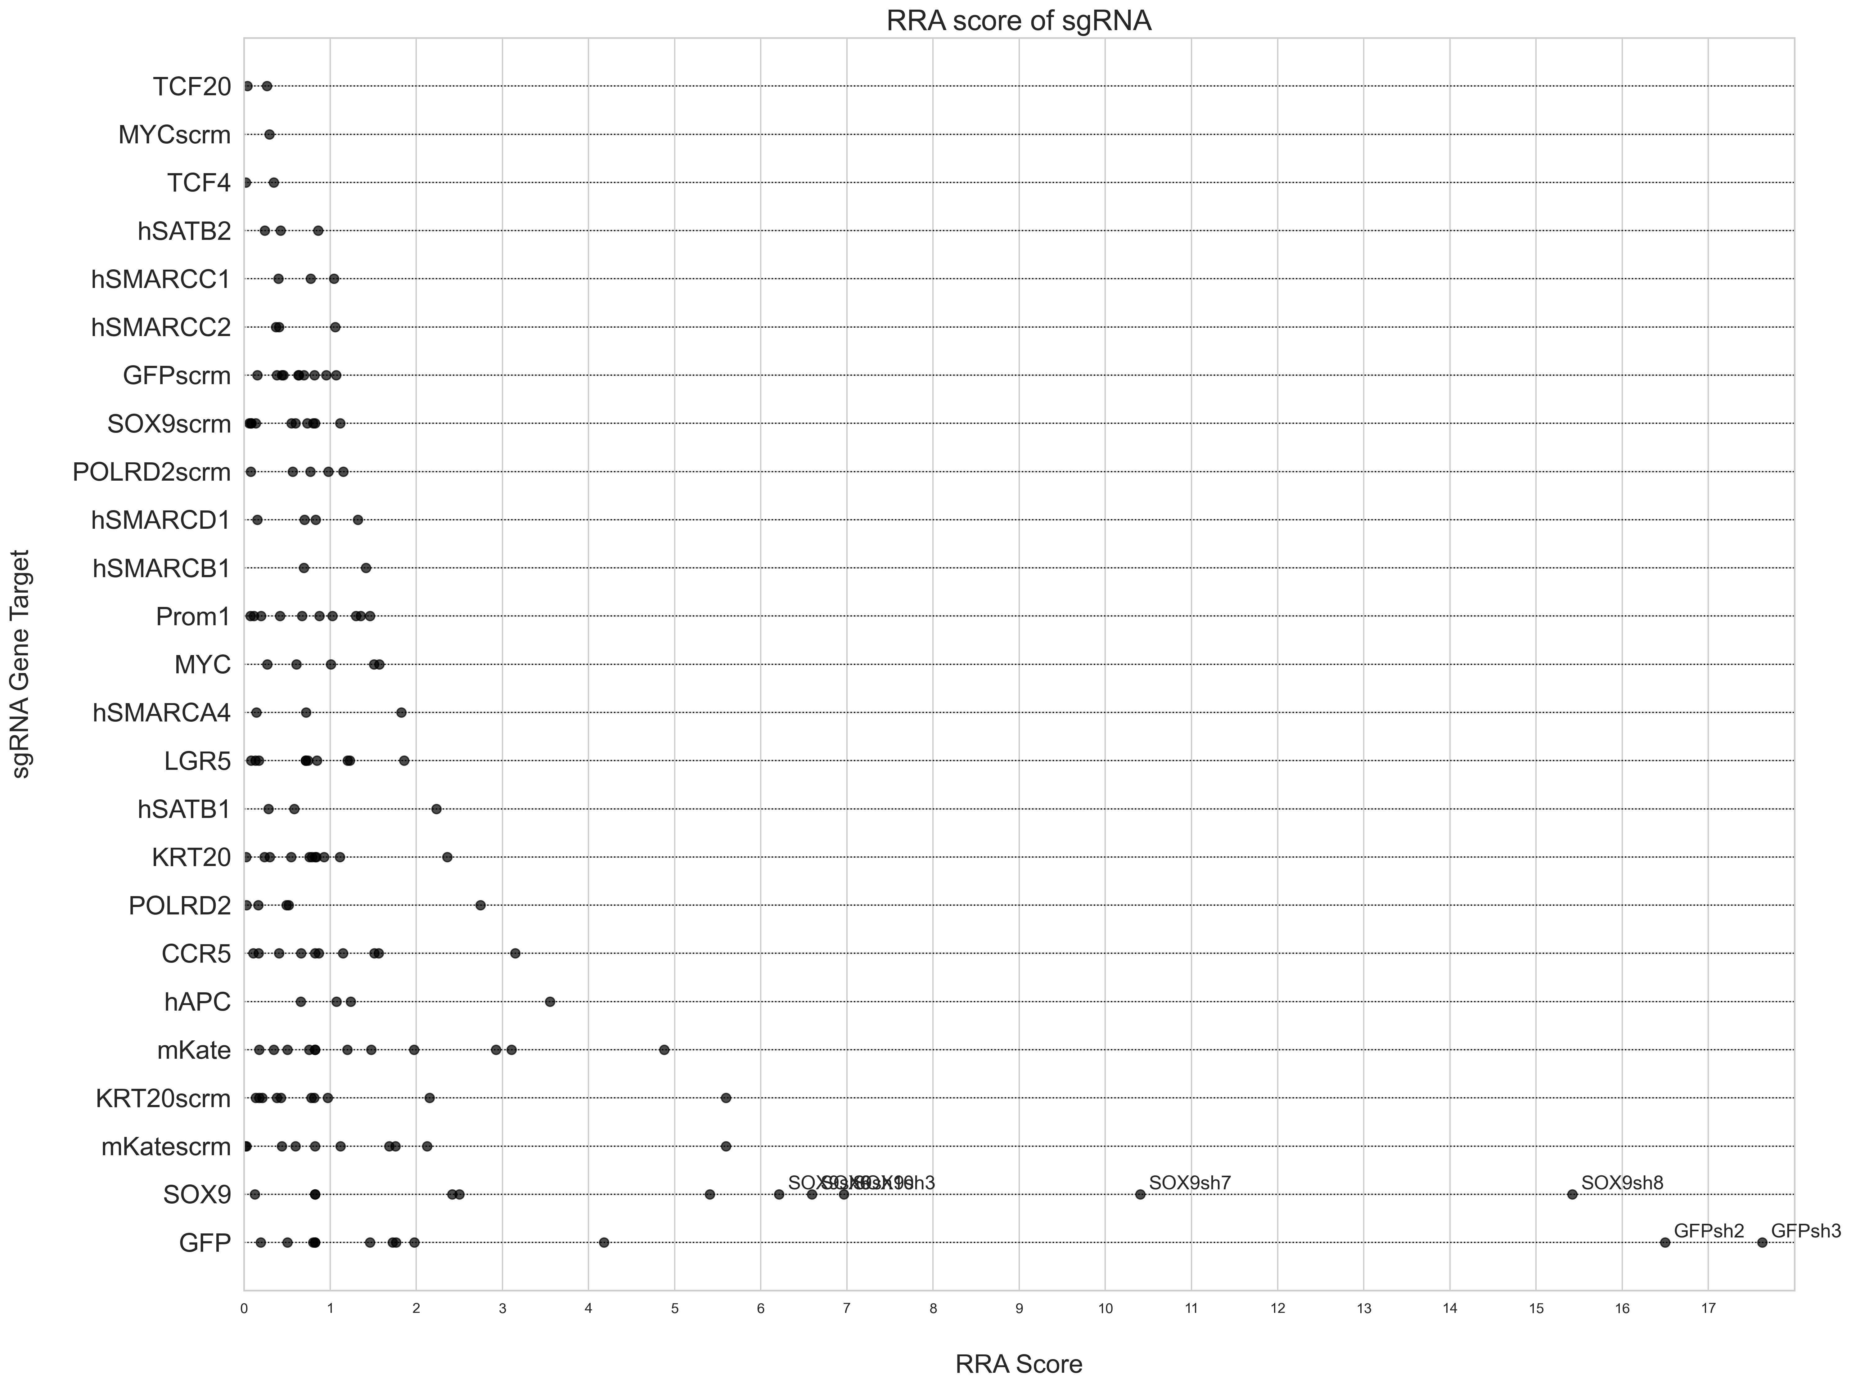
Primer 1: RRA Score
Top 2.5% vs Bottom 5%
Top 2.5% vs Bottom 2.5%
Day 3
Day 7
Day 3
Day 7

Slide 15
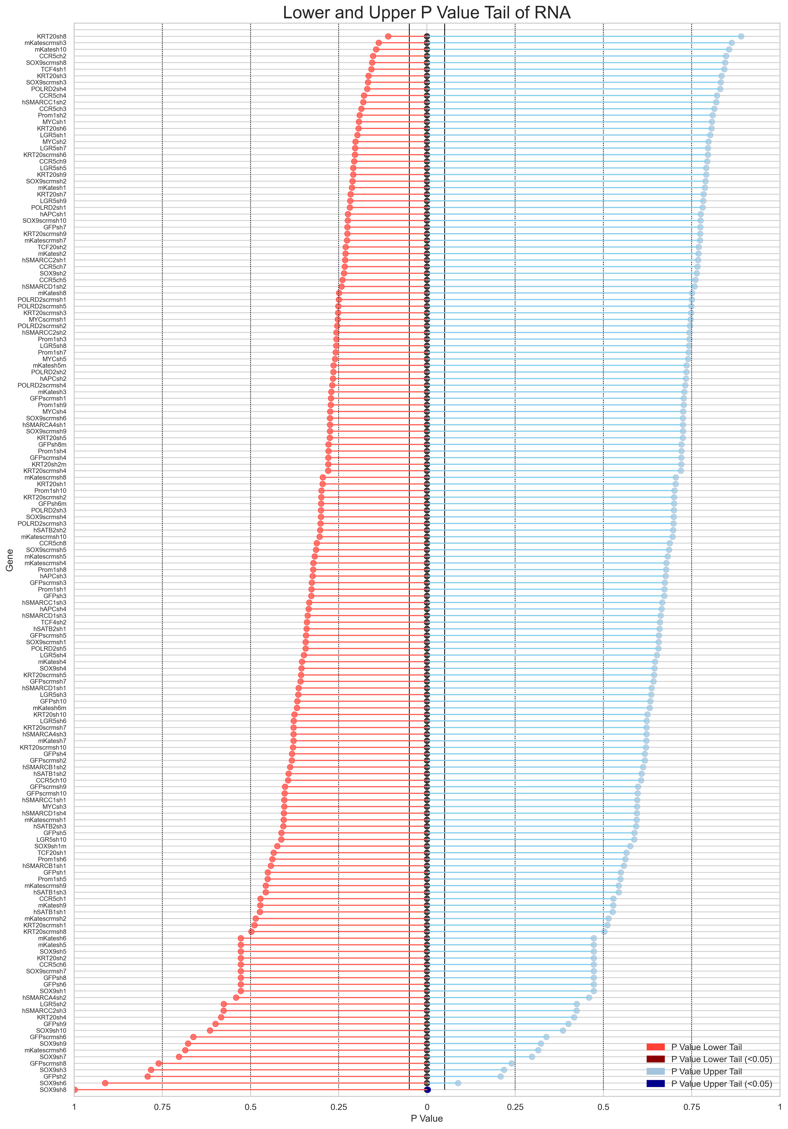
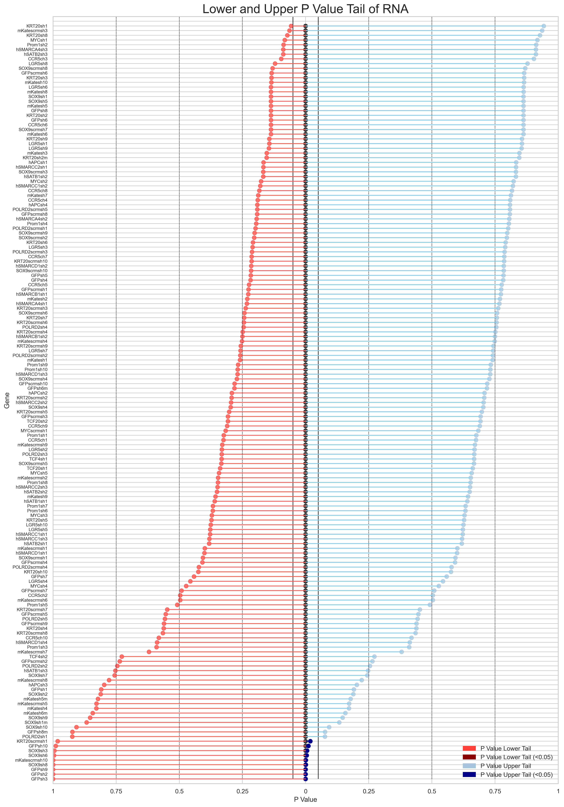
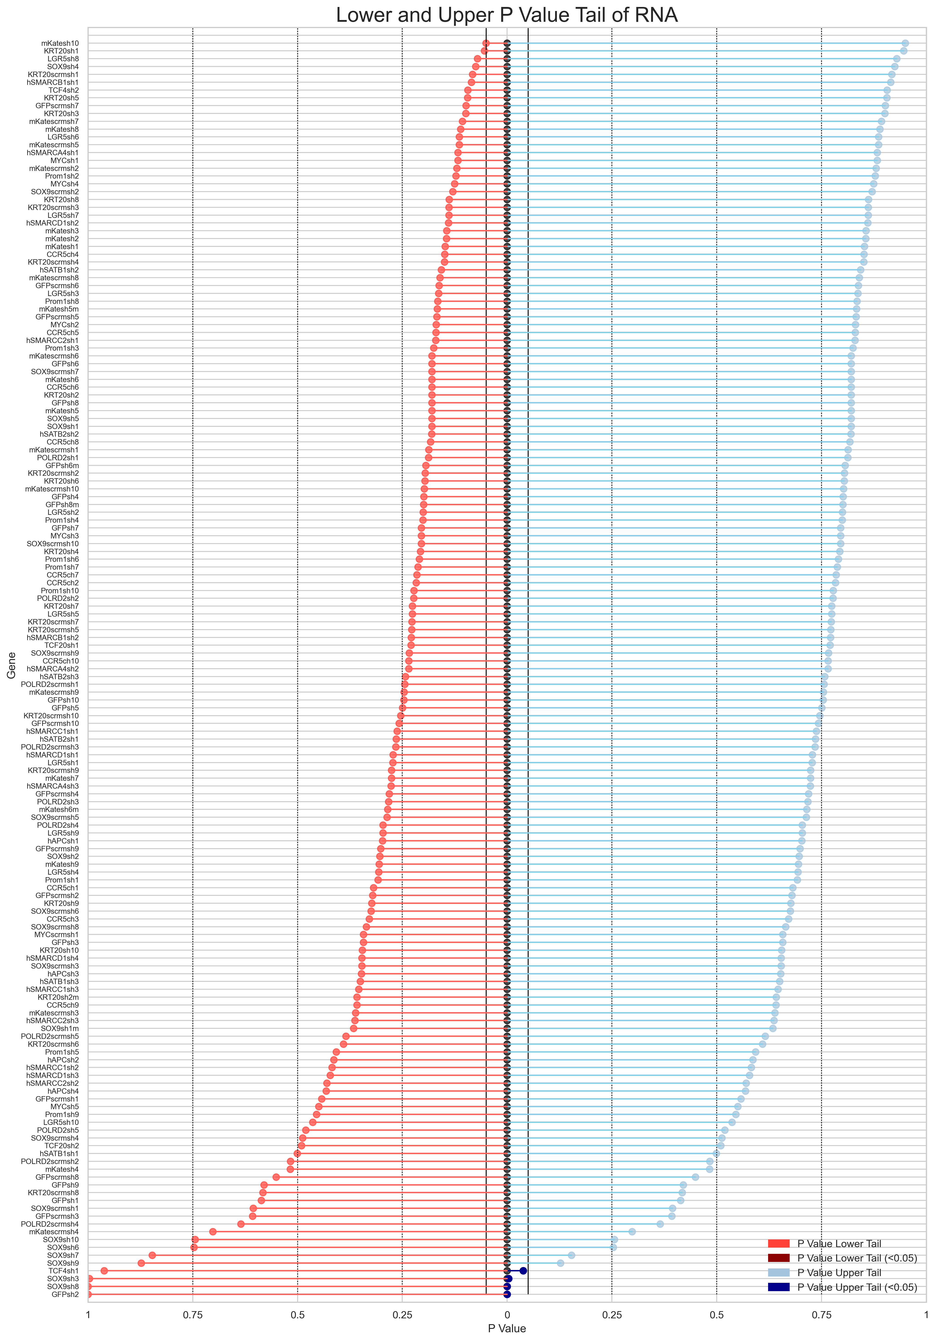
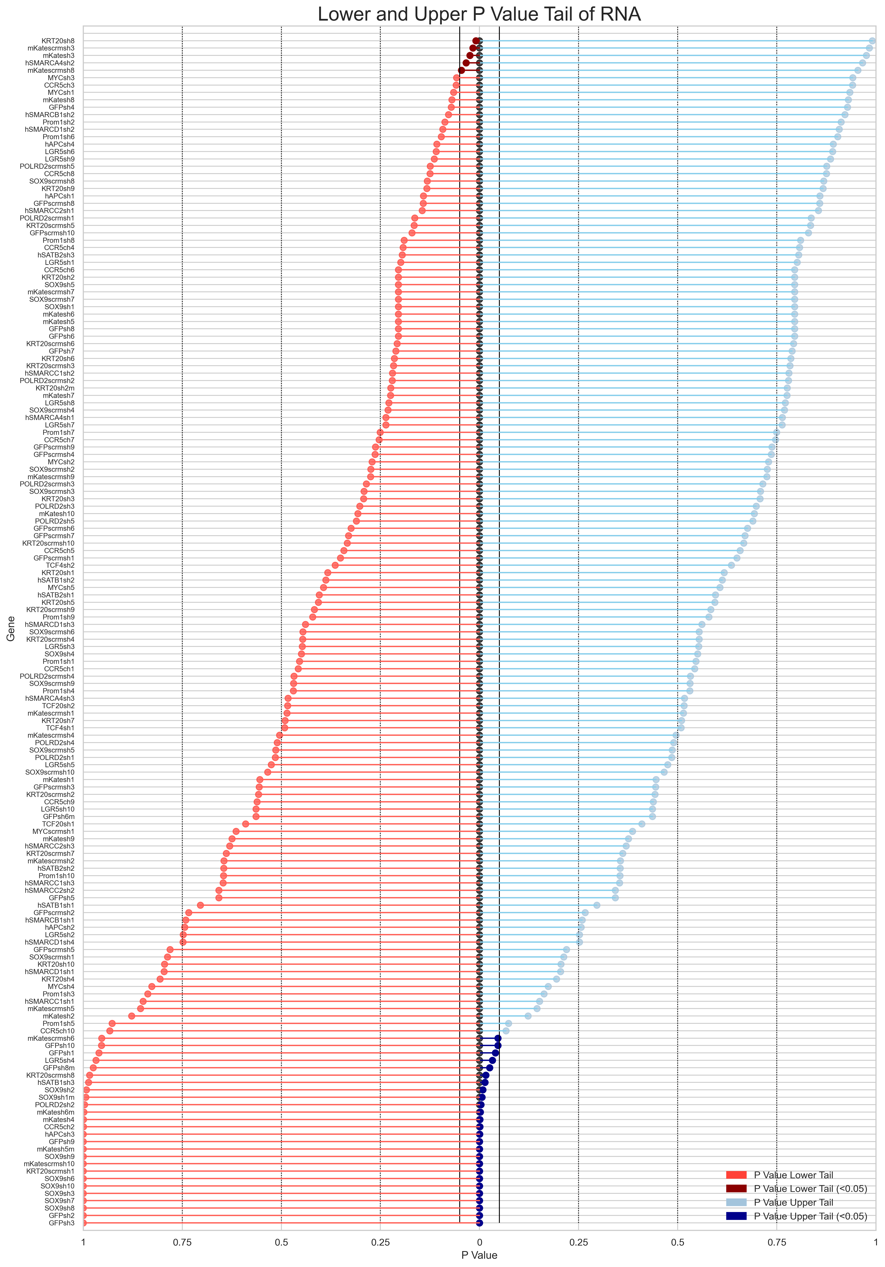
Primer 1: shRNA Upper and Lower Tail P value
Top 2.5% vs Bottom 5%
Top 2.5% vs Bottom 2.5%
Day 3
Day 7
Day 3
Day 7

Slide 16
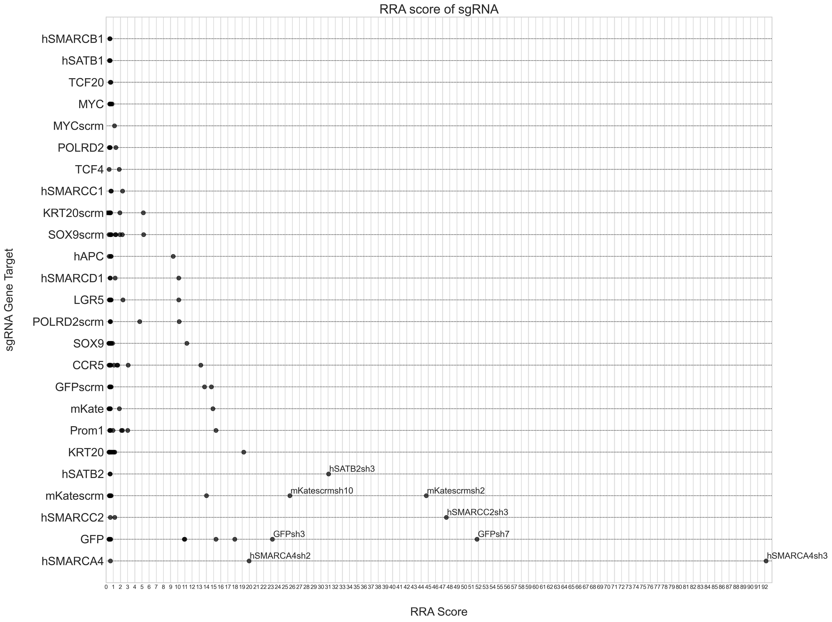
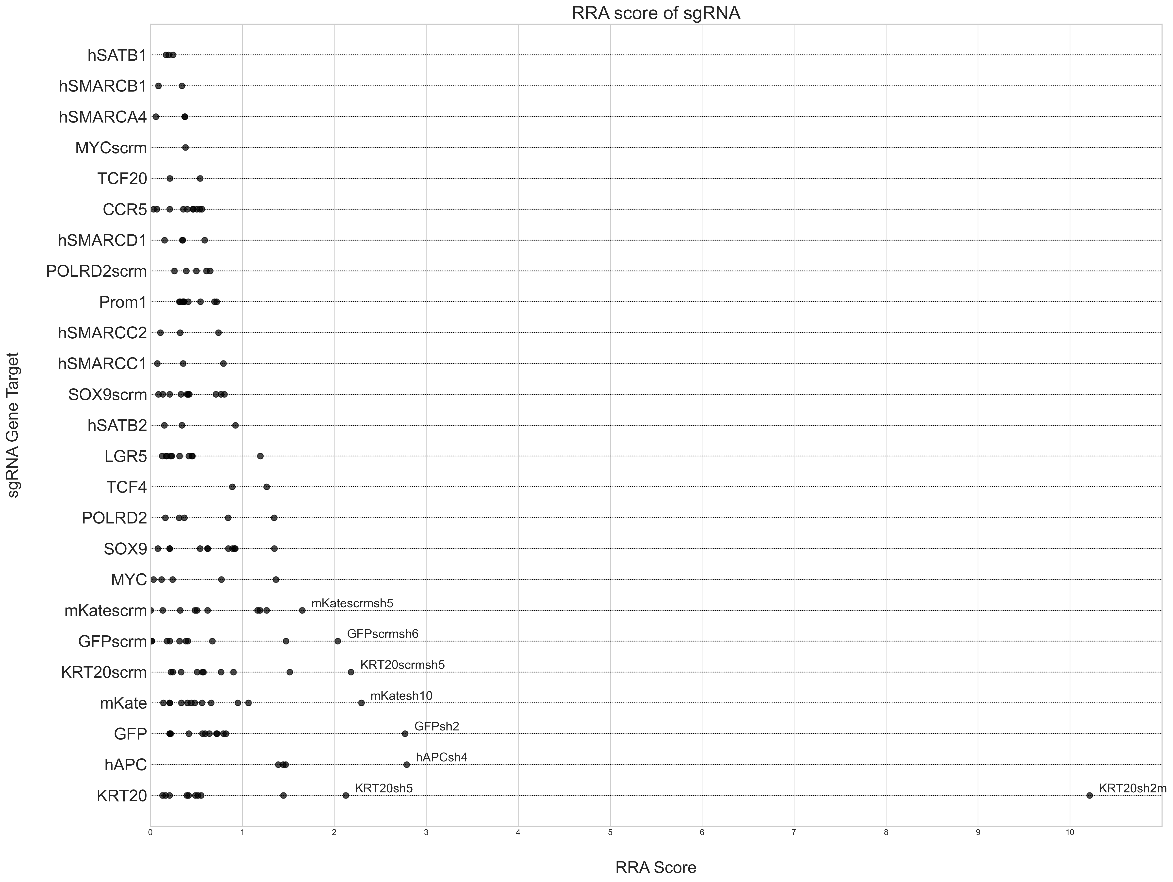
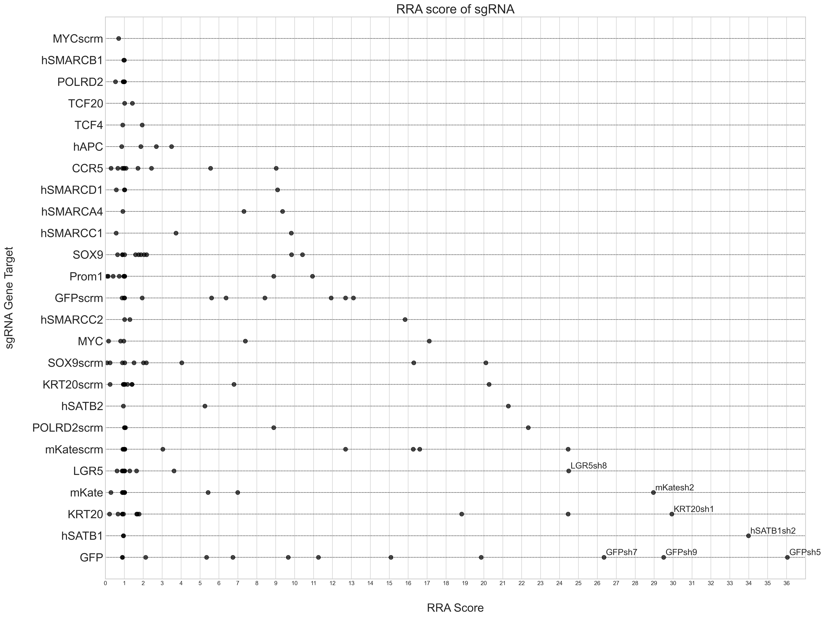
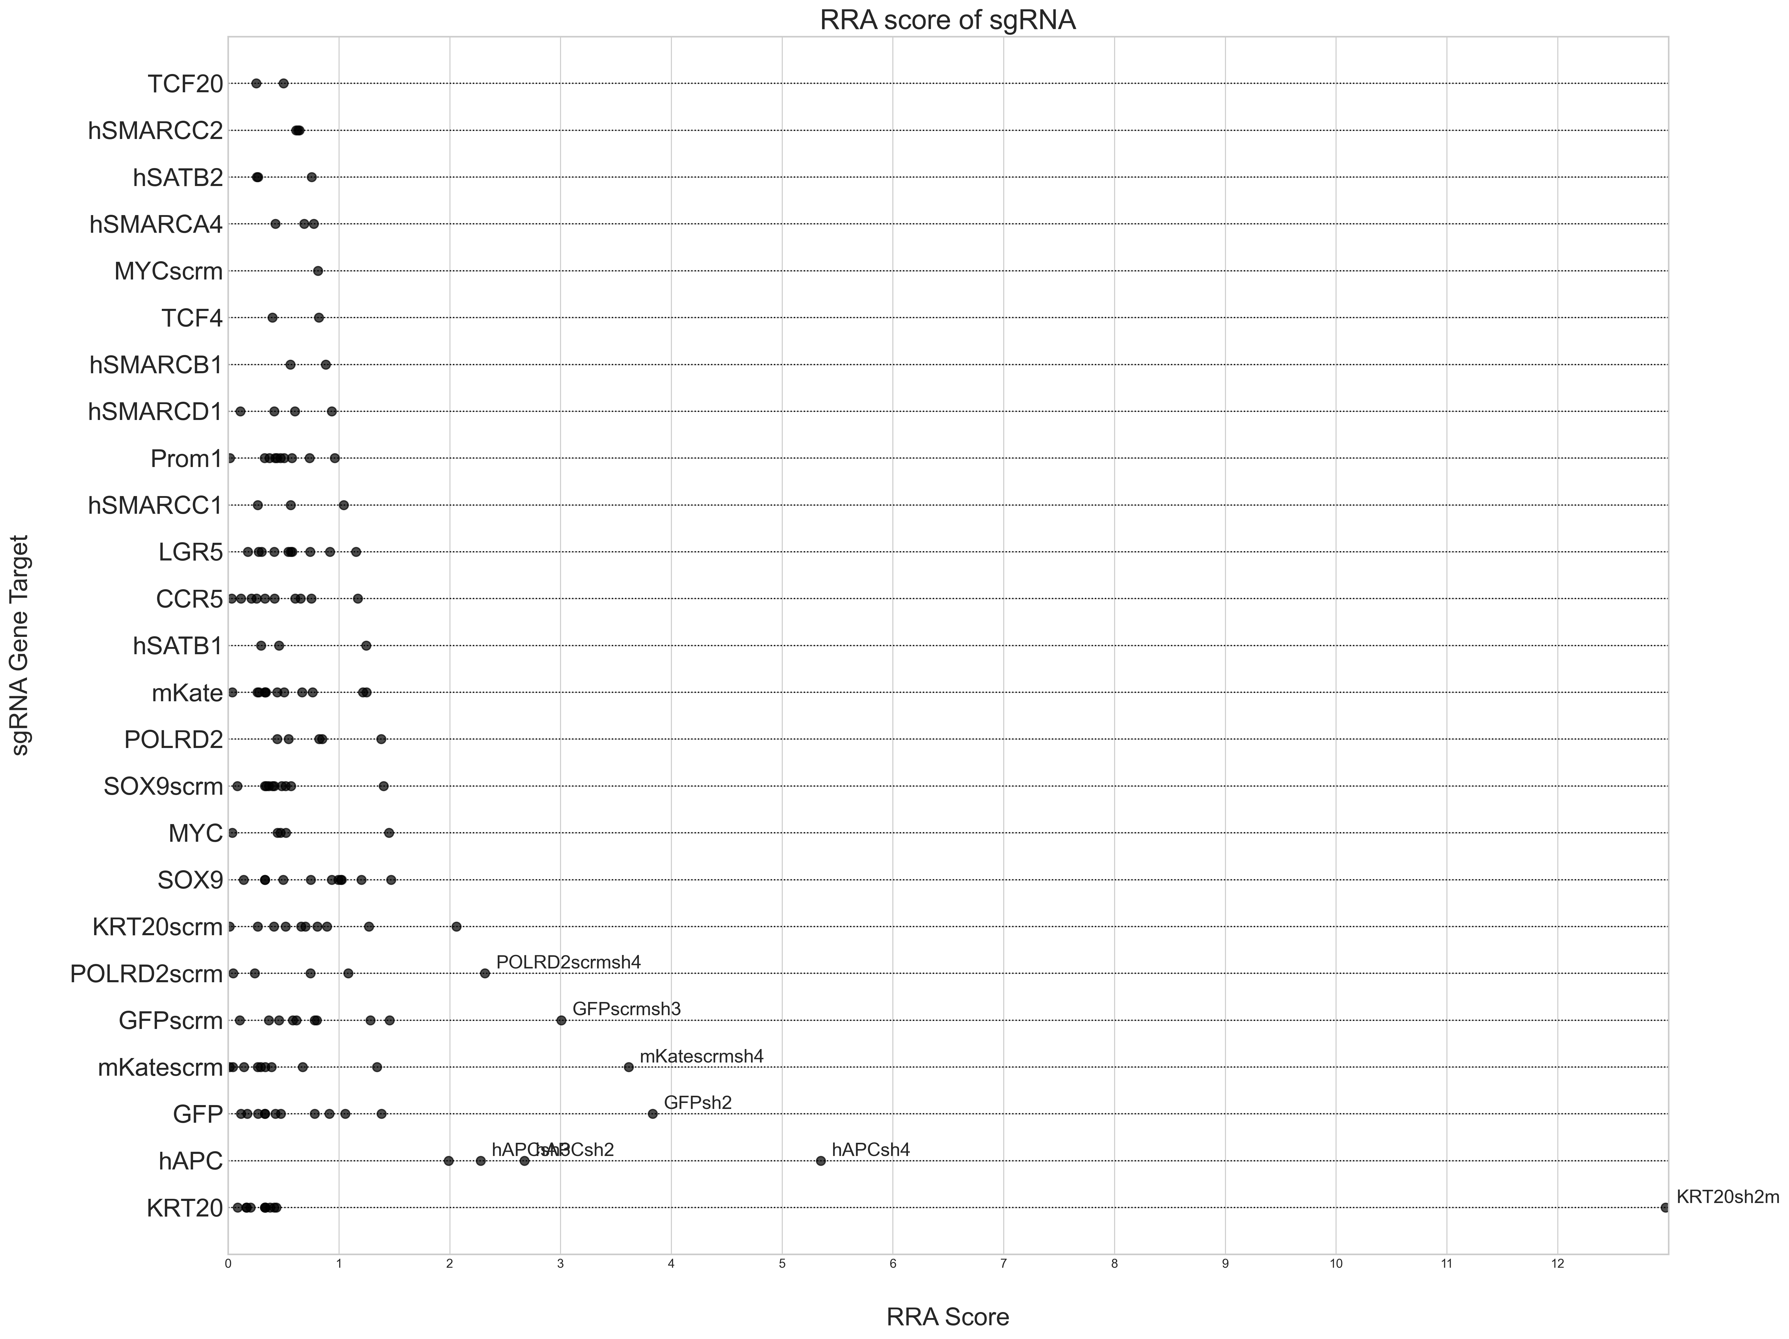
Primer 2: RRA Score
Top 2.5% vs Bottom 5%
Top 2.5% vs Bottom 2.5%
Day 3
Day 7
Day 3
Day 7

Slide 17
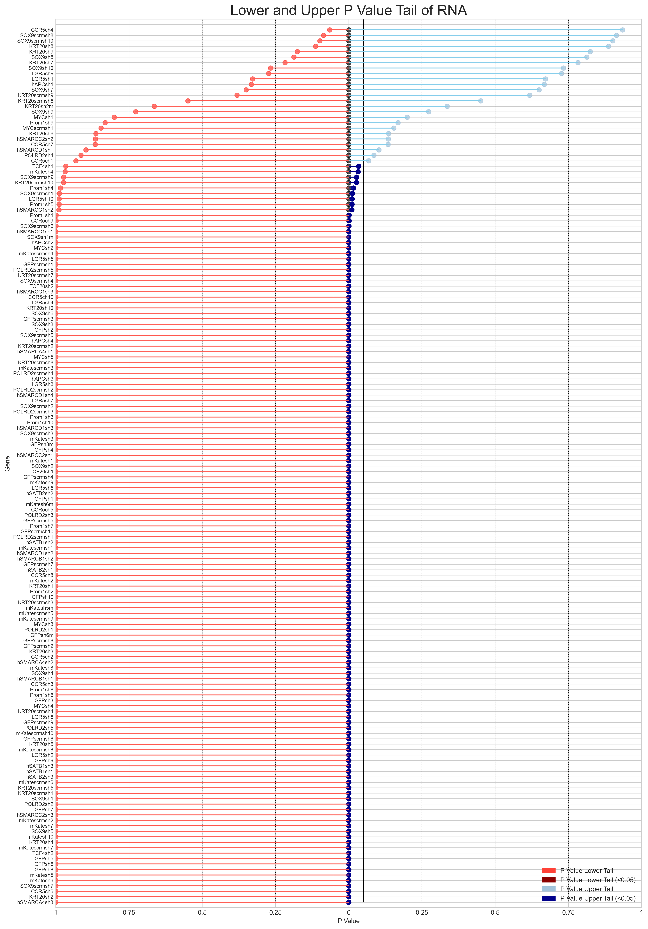
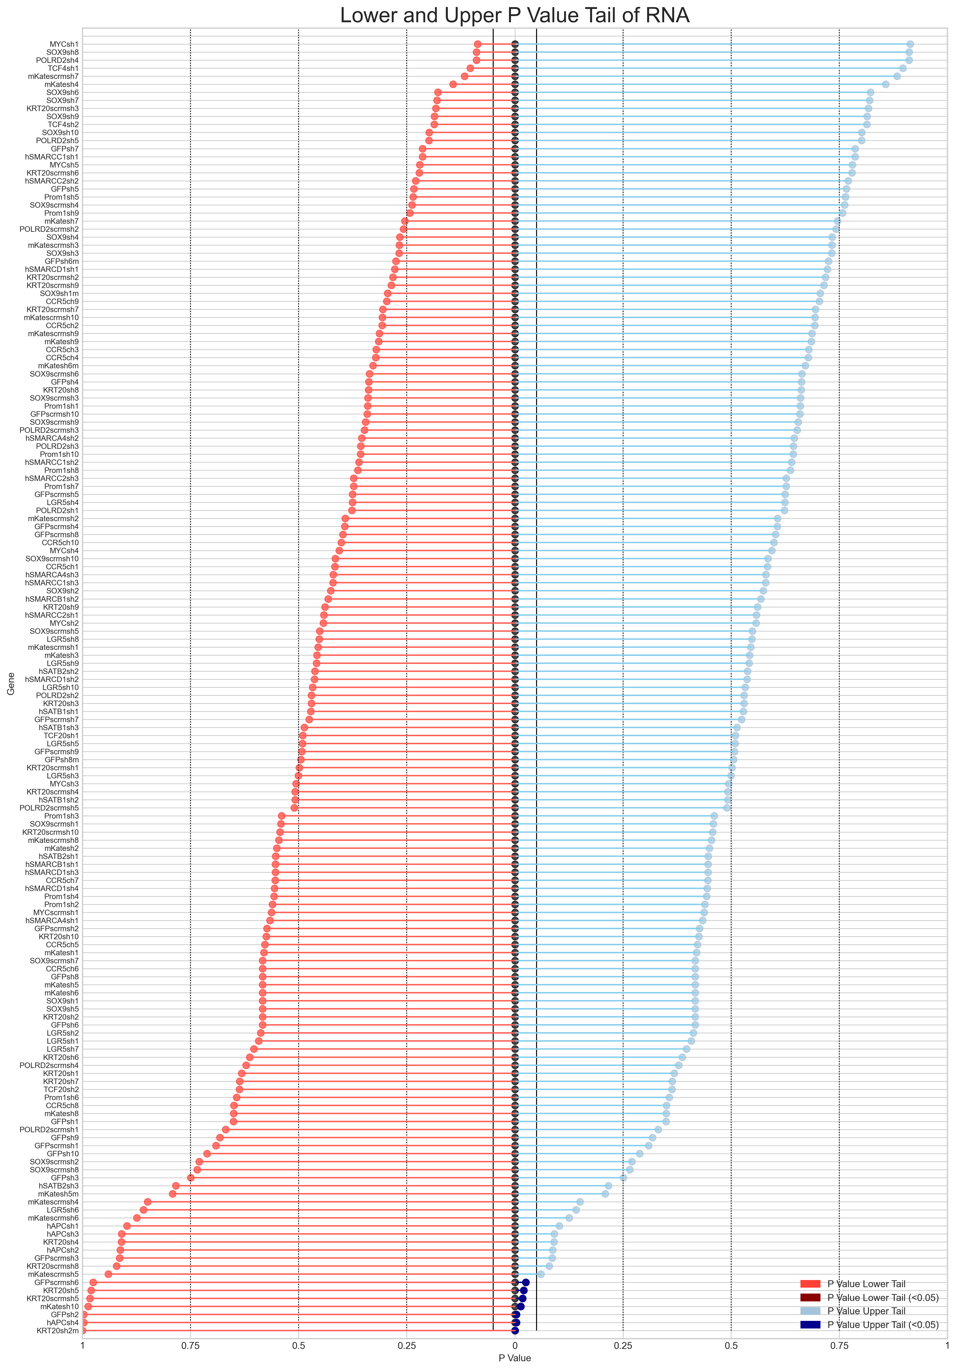
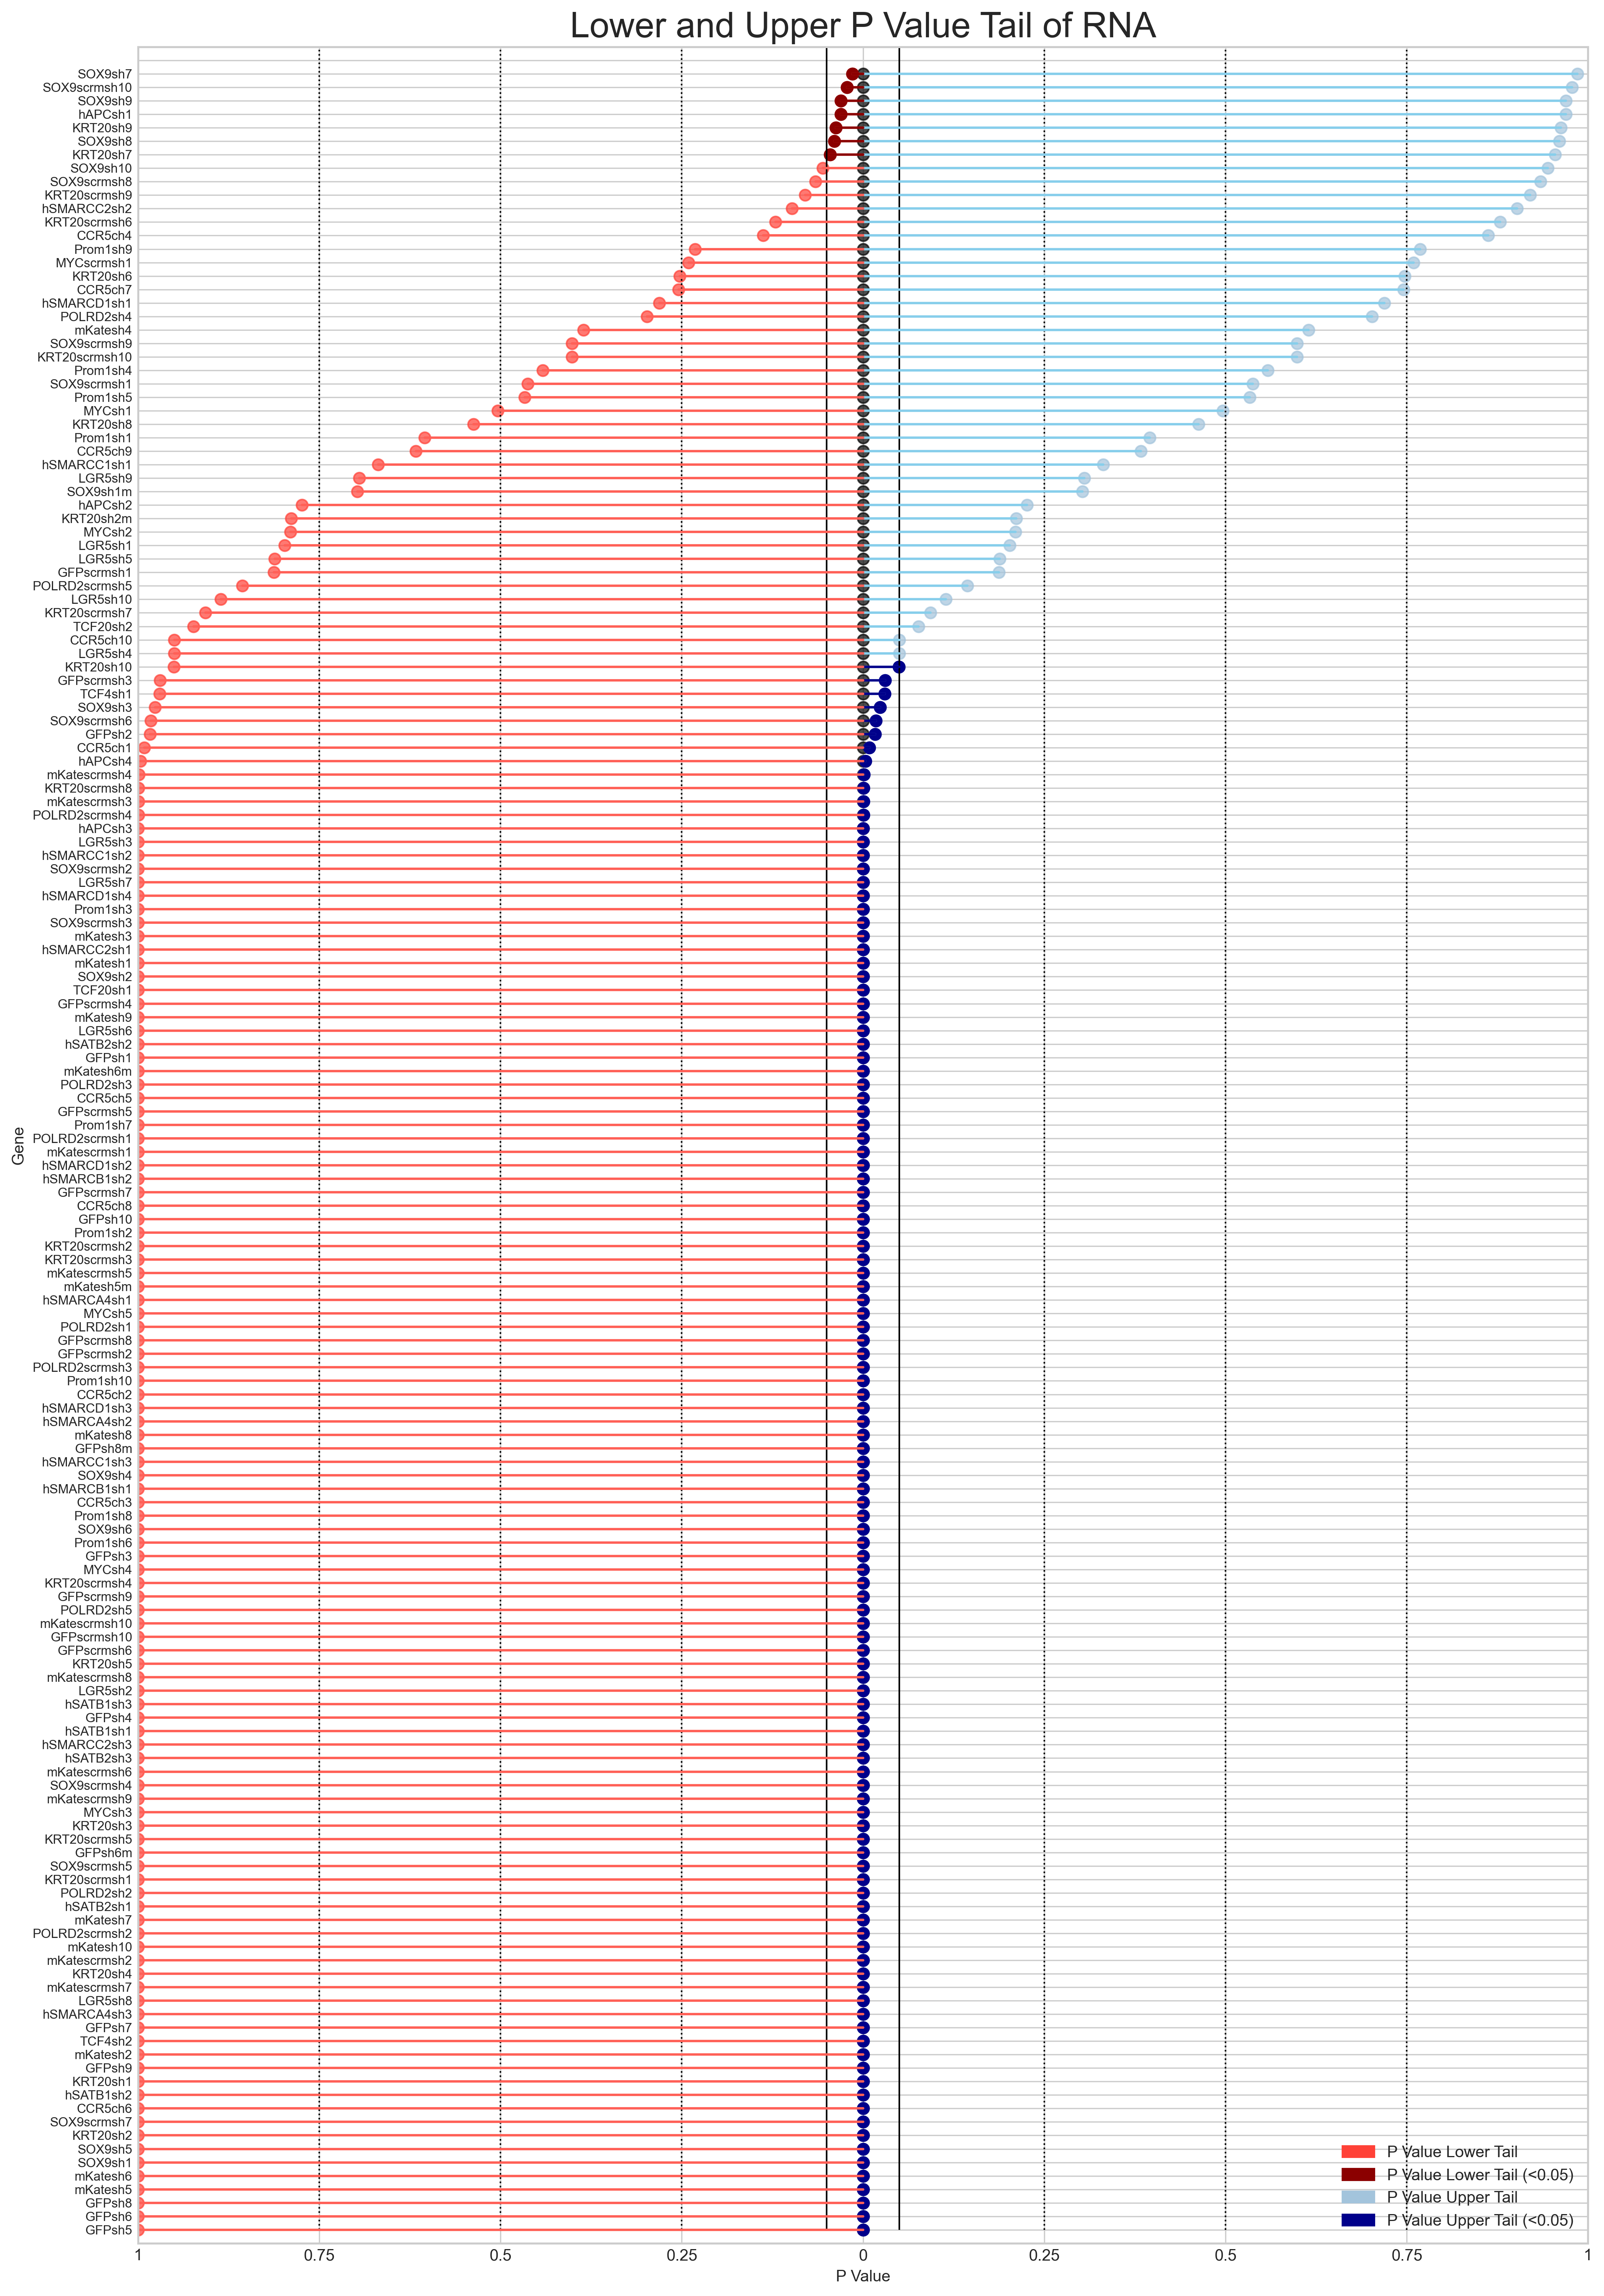
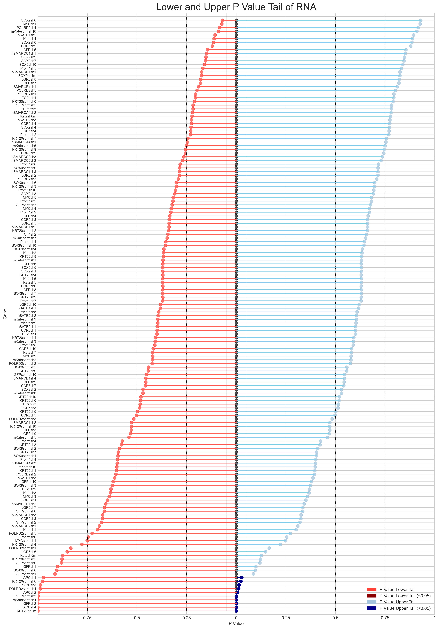
Primer 2: sgRNA Upper and Lower Tail P value
Top 2.5% vs Bottom 5%
Top 2.5% vs Bottom 2.5%
Day 3
Day 7
Day 3
Day 7

Slide 18
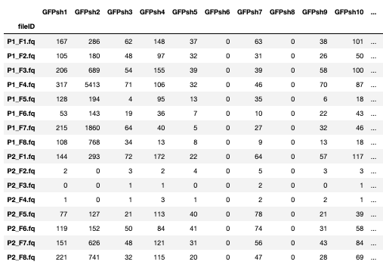
Primer 2 Observation
Zeros:
Day 3, Fraction Top 5%
Day 3, Fraction Bottom 5%
Day 3, Fraction Bottom 2.5%

Slide 19
MaGeCK Maximum Likelihood Estimation
MAGeCK-VISPR includes a new algorithm, ‘MAGeCK-MLE’, to estimate the essentiality of genes in various screening conditions using a maximum likelihood estimation (MLE) approach. Compared with the original MAGeCK algorithm using Robust Rank Aggregation (‘MAGeCK-RRA’) that can only compare samples between two conditions, MAGeCK-MLE is able to model complex experimental designs.

Slide 20
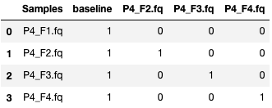
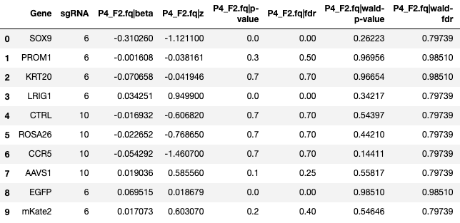
Beta Score
The effects of r different conditions are represented as the score ‘β _{gr} ’, a measurement of gene selections similar to the term of ‘log fold change’ in differential expression analysis.
‘β’ scores reflect the extent of selection in each condition: β _{gr} >0 (or <0) means g is positively (or negatively) selected in condition r. μ _{ij} is also dependent on β _{i0}, the initial sgRNA abundance which is usually measured in plasmid or the day 0 of the experiment.
Design Matrix File: Primer 4 – Day 3
MLE Gene Statistics: Primer 4

Slide 21
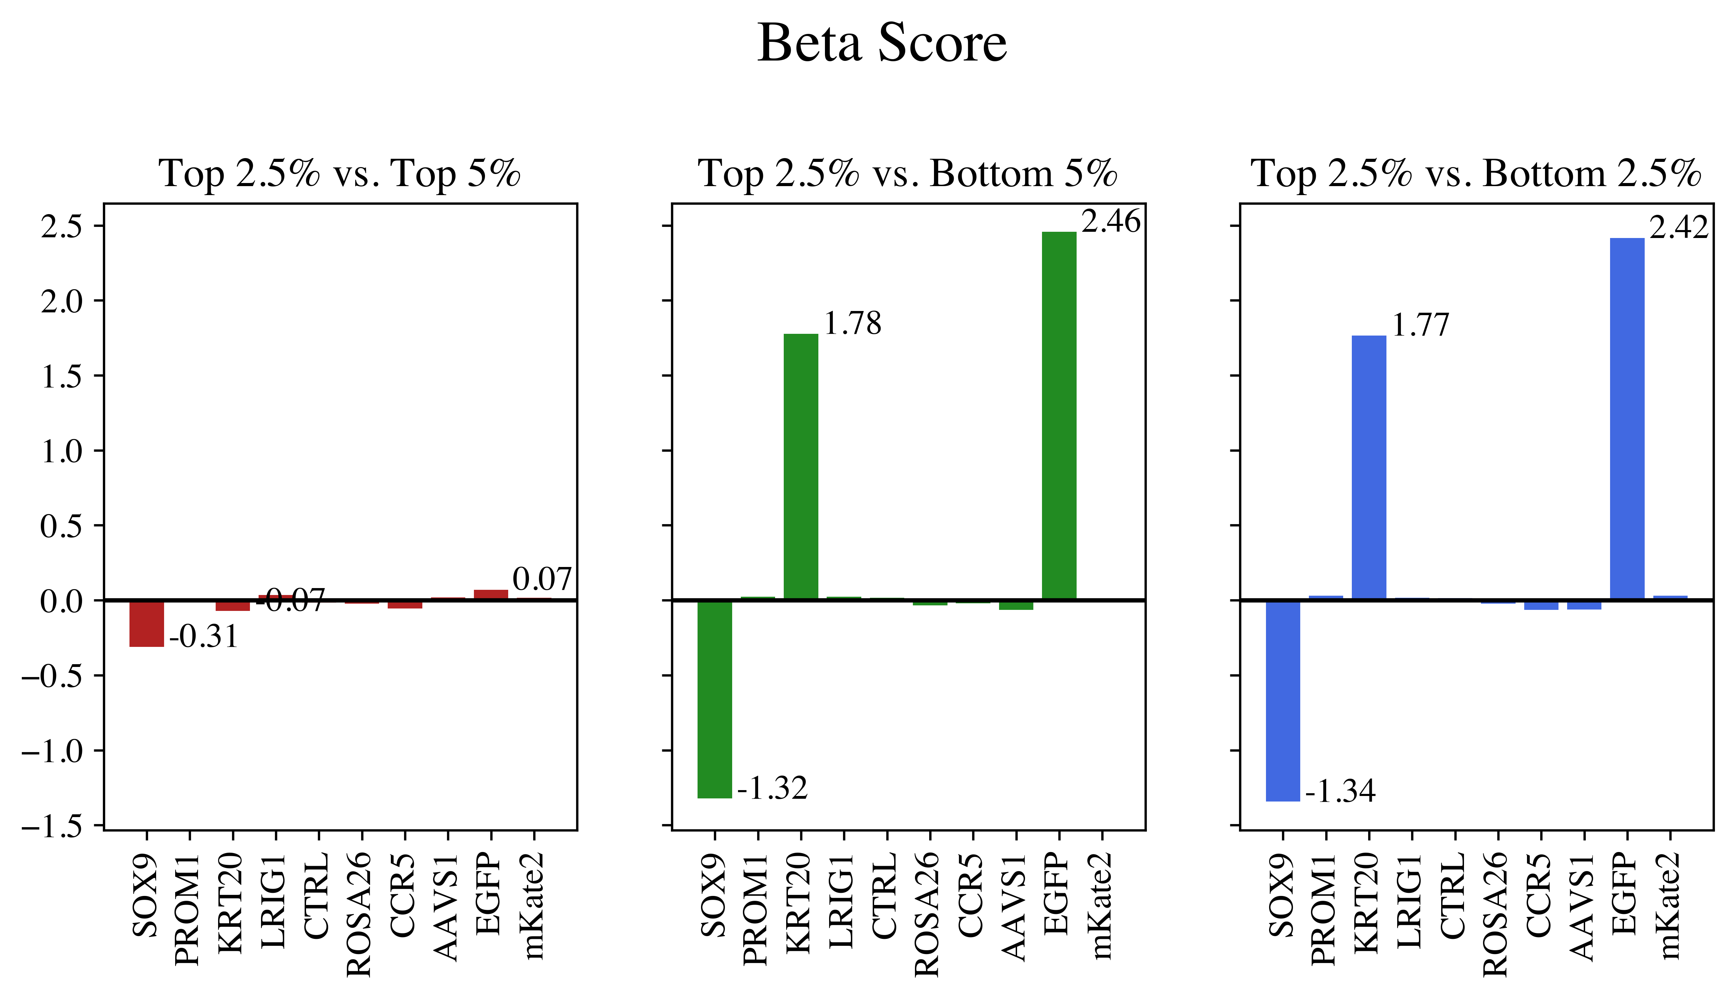
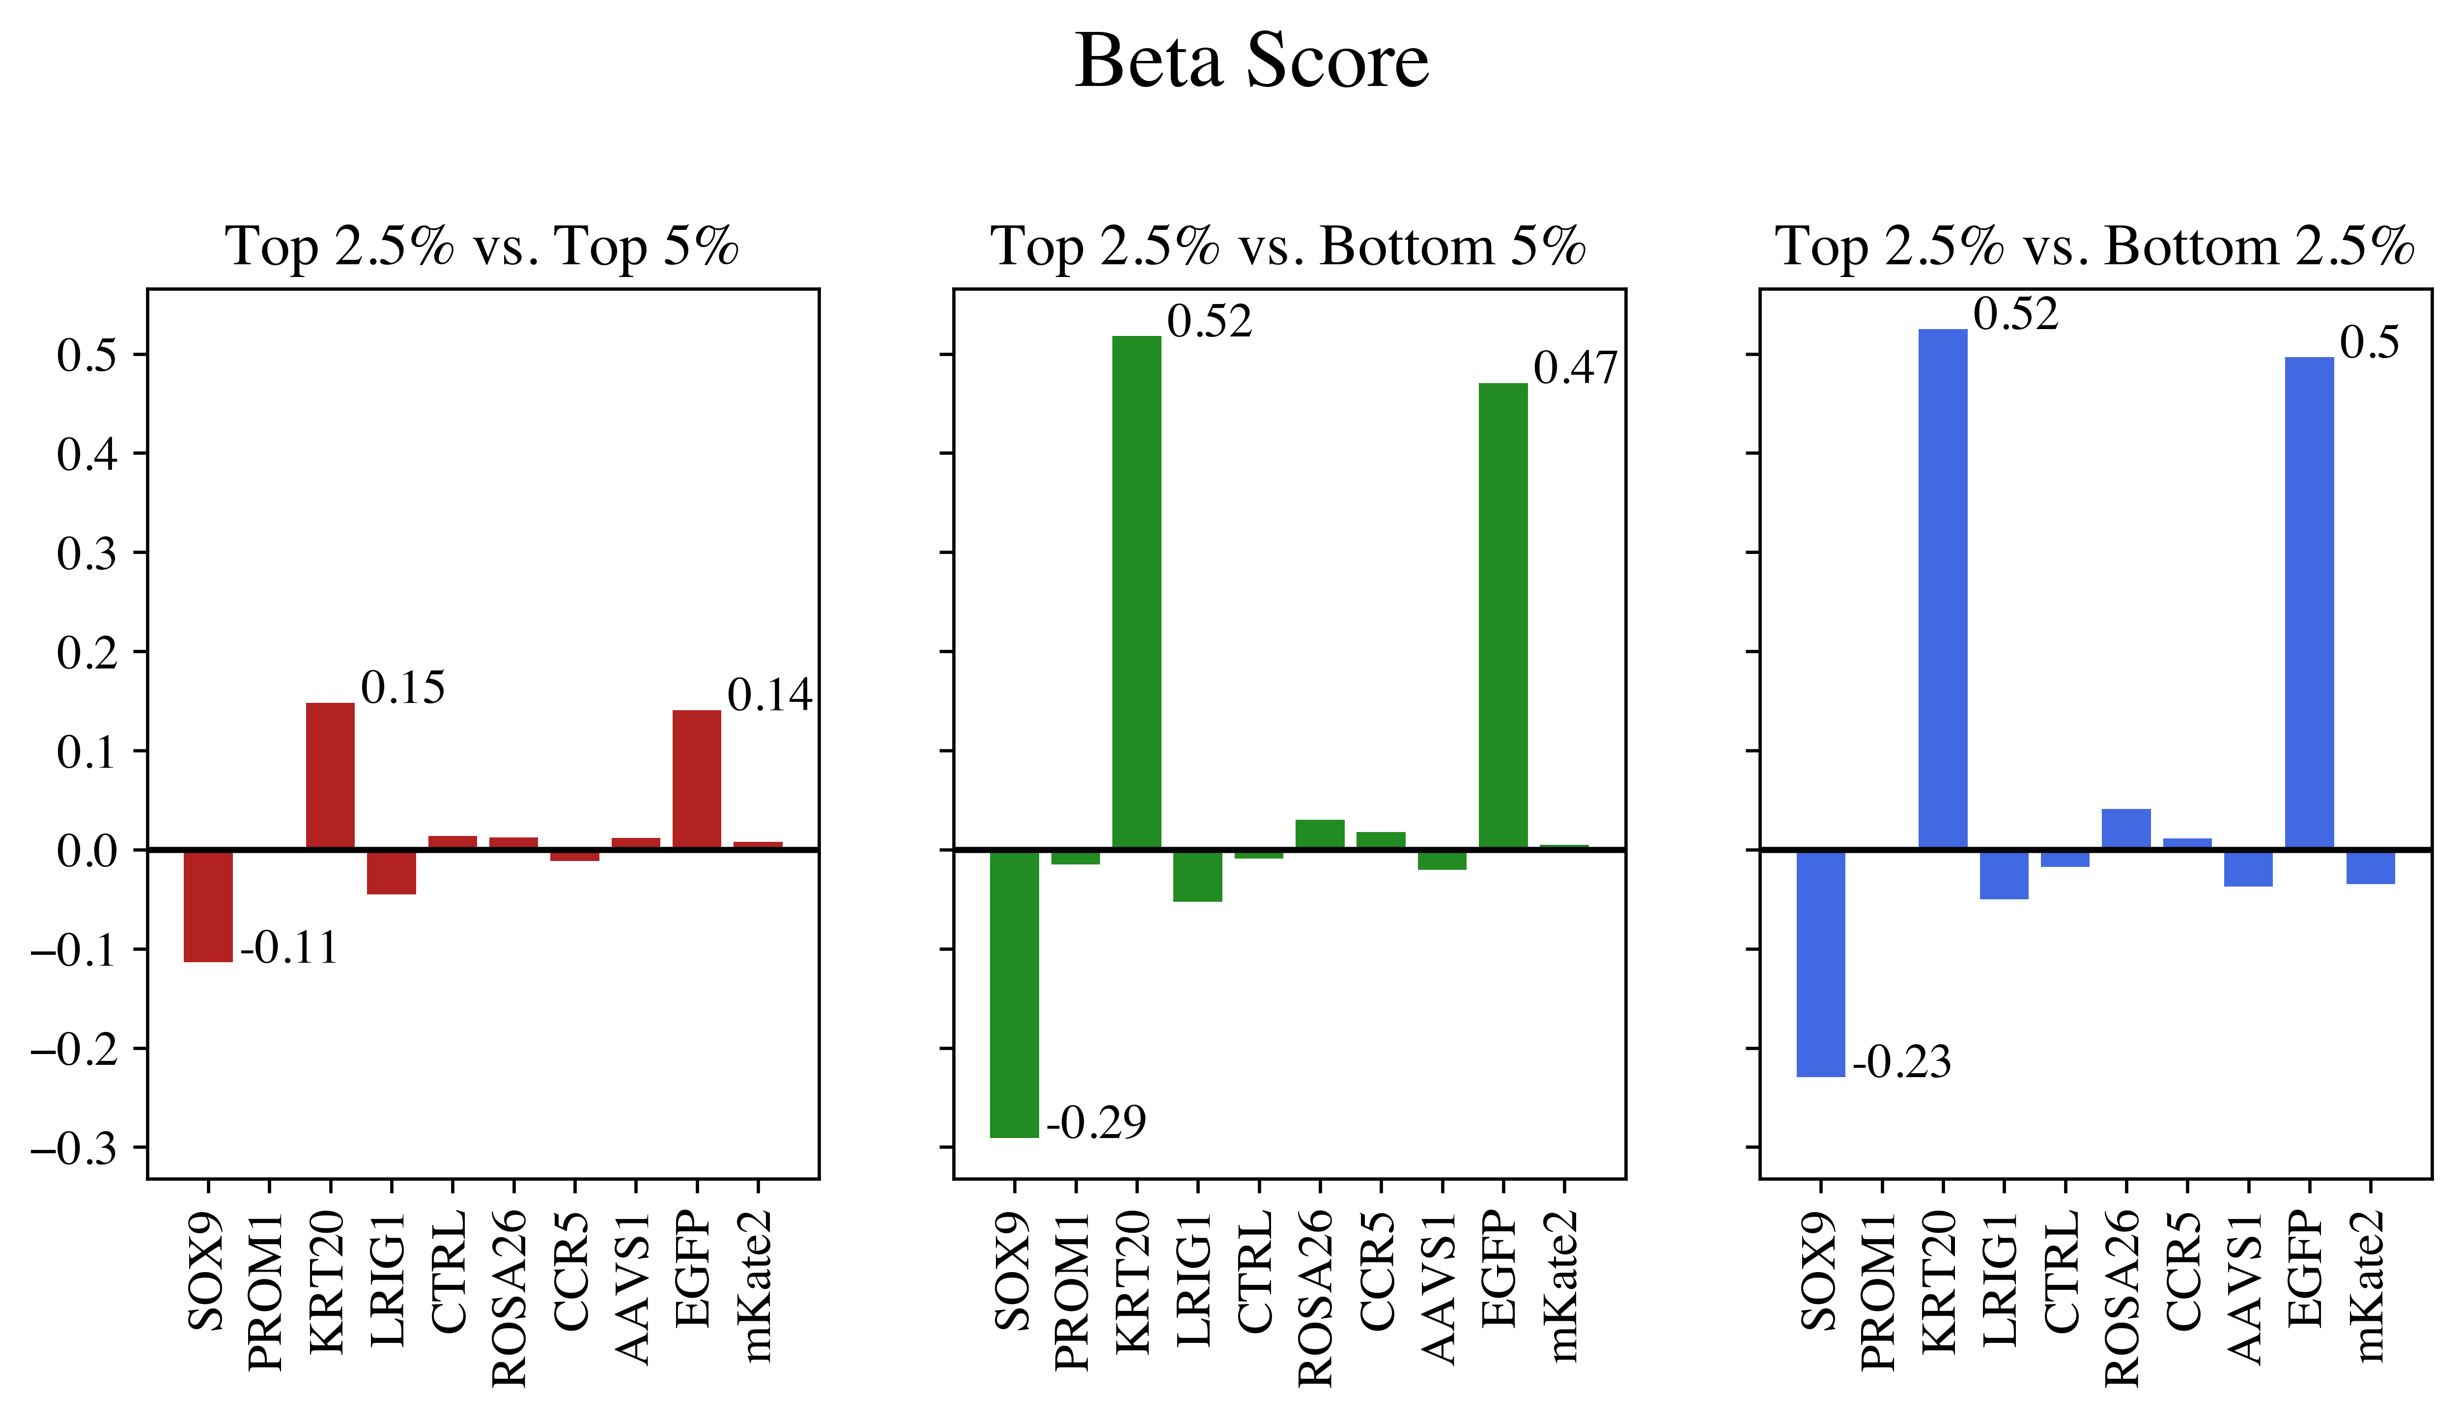
Primer 4 - Beta Score
Day 3
Day 7

Slide 22
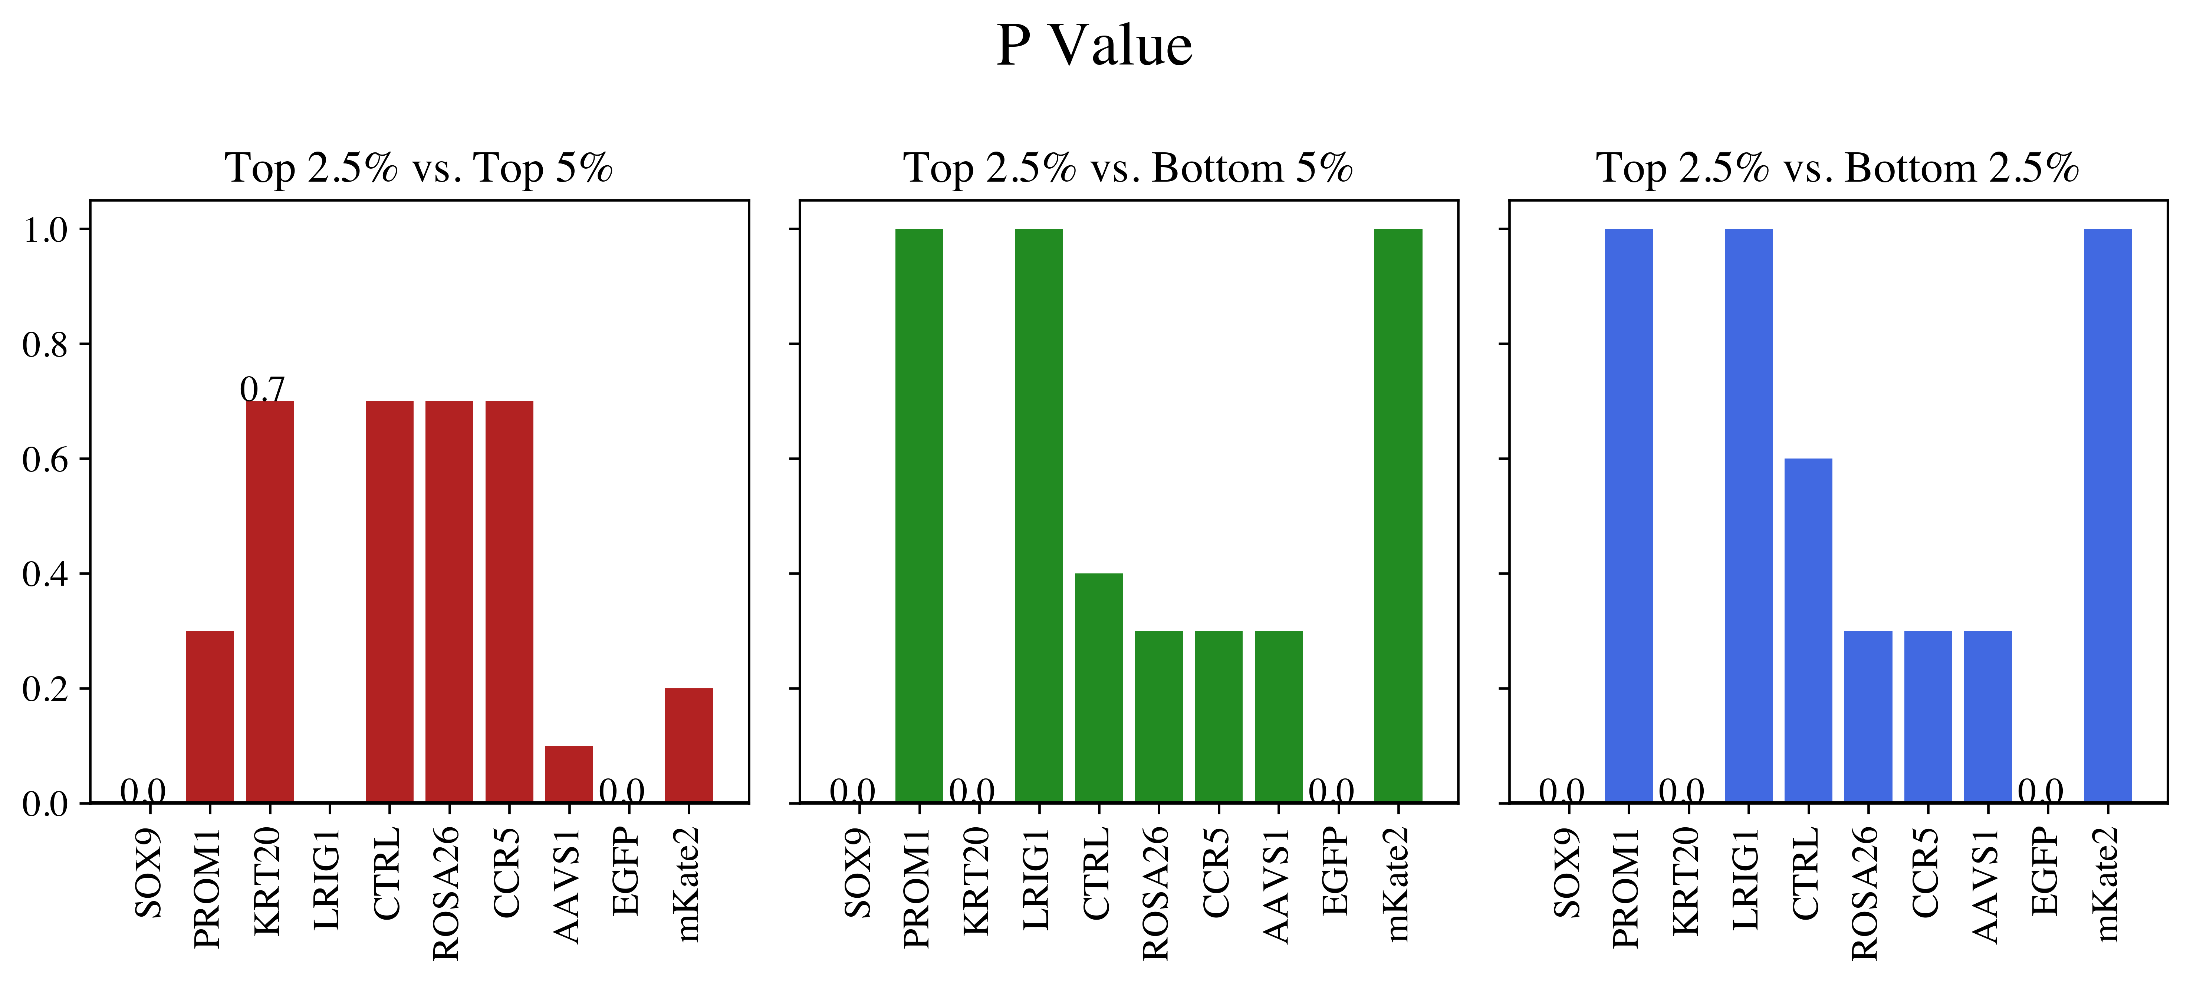
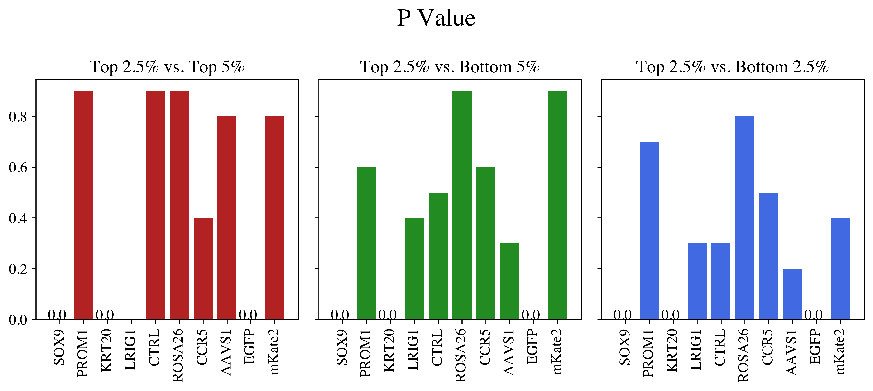
Primer 4 - P Value
Day 3
Day 7

Slide 23


Primer 4 - False Discovery Rate
The FDR is the rate that features called significant are truly null.
FDR = expected (# false predictions/ # total predictions)
Day 3
Day 7

